Slide 1

Notes:
Hi everyone! I’m Caleb, and I’m so glad you’re spending some time with me today. This is my talk, Postman…
Wait, that’s not the title on the schedule.

Slide 2

THE LEGEND OF
BREATH OF THE API
Notes:
My talk, The Legend of
No, that’s not right either.

Slide 3

Not just the
Notes:
Nope, nope, nope.

Slide 4
And
newman
API Testing Made Easy
Notes:
There it is.

Slide 5





Caleb Meyer
Notes:
Hi I’m Caleb Meyer, and I love board games, espresso drinks, and piano.

Slide 6
the
Caleb Meyer
Senior Software Engineer
Dad of the Millennium (Falcon)
Arbiter of Documentation
Script Ninja
Veteran Mercenary
Notes:
I also love titles. I find that these are a fun way to recognize what someone is good at. Give your friends and coworkers some titles too. You can give yourself titles as well, but they won’t stick until you give a DevCon talk and put them on a slide. All of these except the first were given to me by my coworkers.
But today my title is expert slide developer and novice public speaker, so let’s continue with what you’re going to learn in today’s talk.

Slide 7
History
Basics
Requests
Covered Today
Collections
Variables
Testing
Advanced
Notes:
Today we’re going to cover a lot, including the what, how, and why of Postman. What is a postman? How do I use it? Why would I use it? And we’re going to start with how it all got started.

Slide 8
Postman started as
a Chrome Extension
Side Project
Notes:
Today postman is a whole separate application with a suite of services attached. But it started as a lowly chrome extension.
Original developer Abhinav Asthana says in 2012 he was a coding intern whose job was to take APIs and convert them into a shareable format. He kept running into the same problem over and over: it was too hard to figure out how APIs worked.
And what do good programmers do when something is hard? He wrote some code to scratch that itch and announced it as an answer on StackOverflow.
After the first half a million users, Abhinav realized that there was a business opportunity here and created a startup with his fellow intern. That turned into the postman we know and love today.

Slide 9
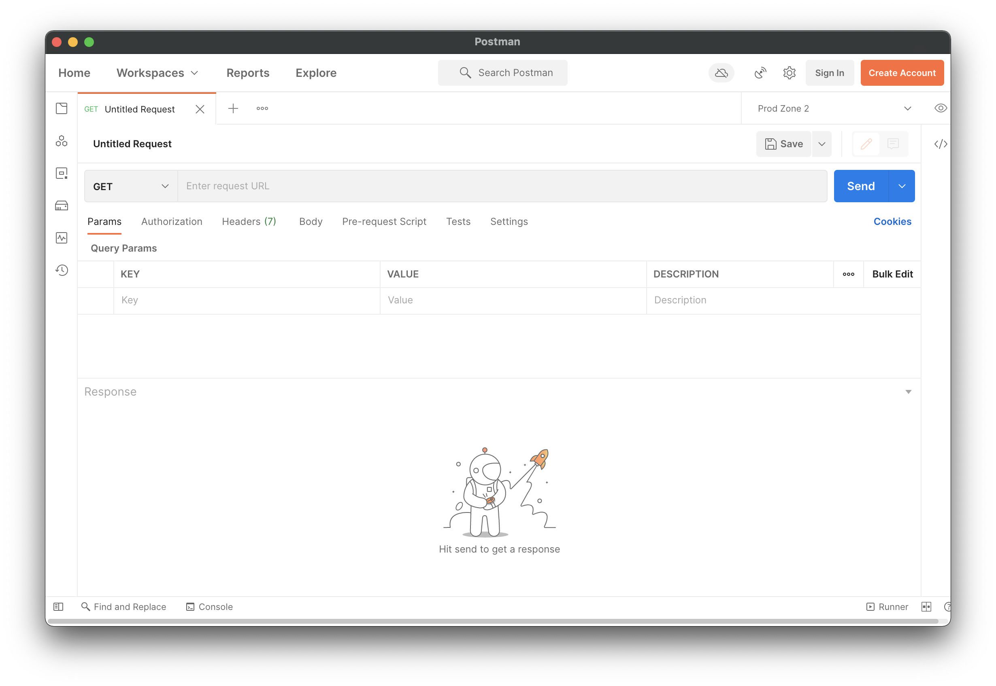
Too bright!
Notes:
So, let’s jump into the app itself.
But… argh… As you all certainly know, most developers are secretly vampires, and those that aren’t vampires are energy conscious, so we are going to have to get rid of this brilliant white monstrosity. Head into your settings and change that theme to dark!

Slide 10
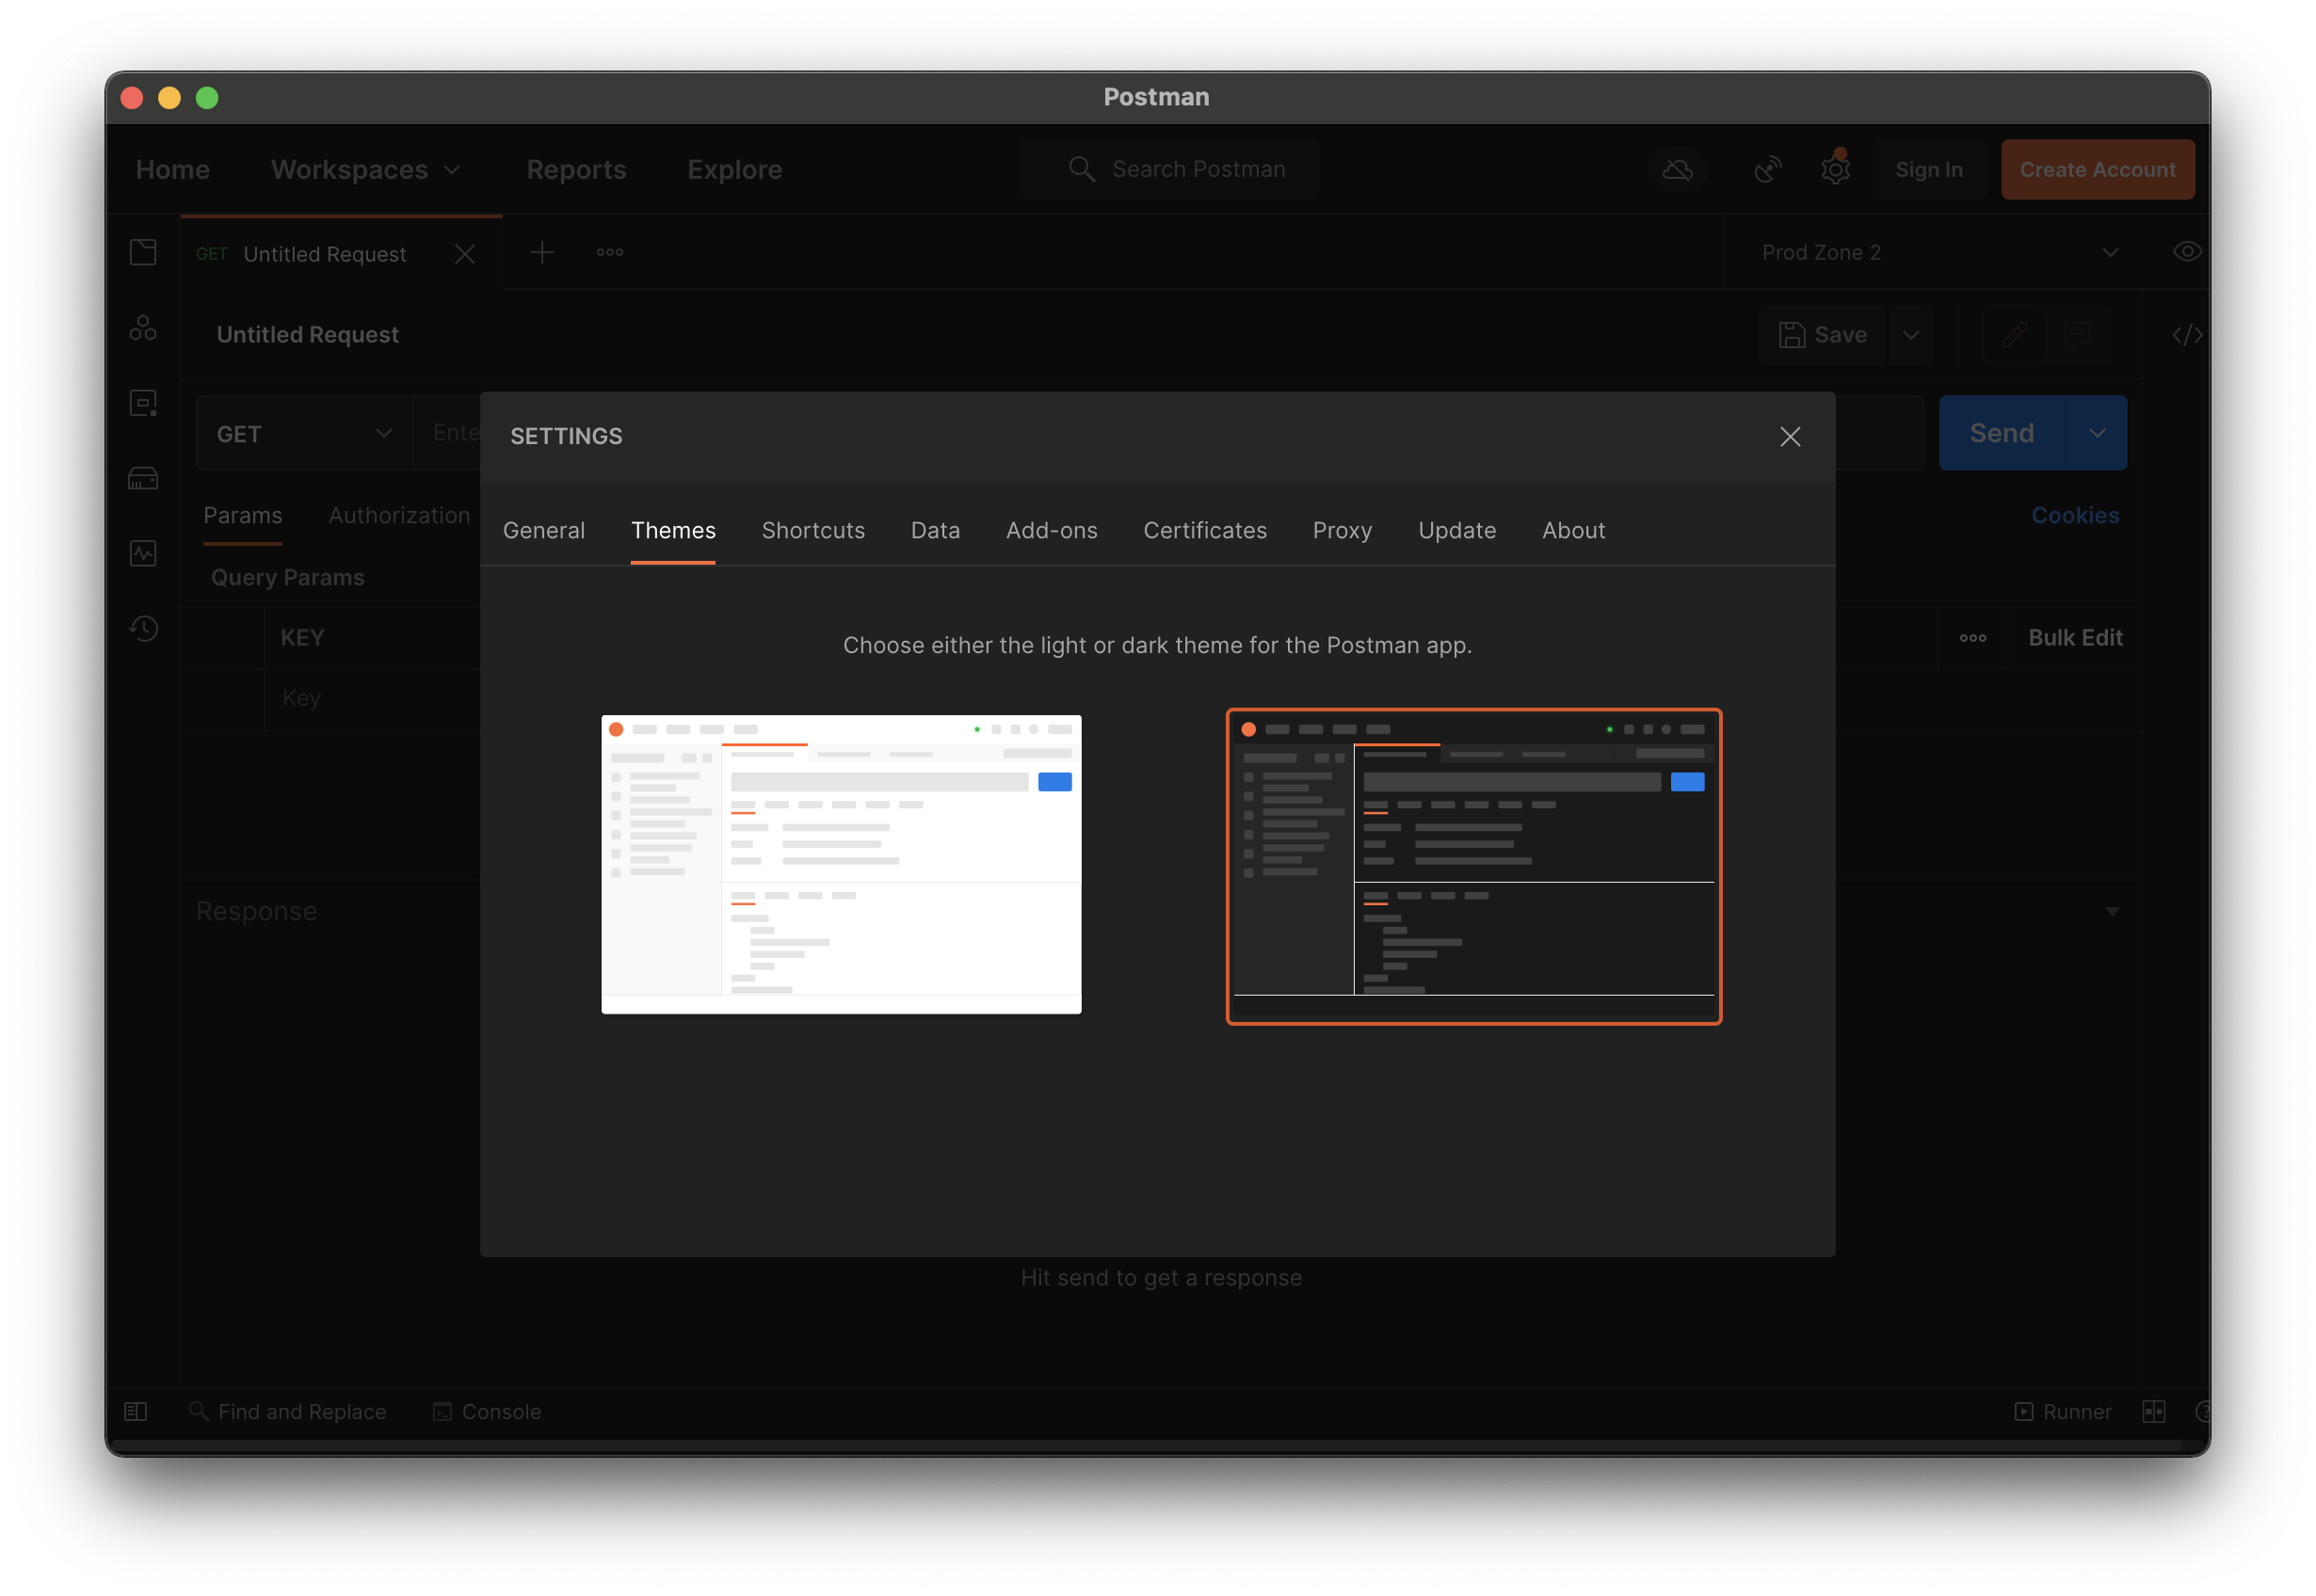
Much Better!
Notes:
Whew. That was a close one. This looks much better. I’ll note that I’m running this on my work mac, but postman is completely cross platform. You can run it on whatever computer you have.

Slide 11
h t t p : //
y
p
e
r
e
x
t
ransfer
r
o
t
o
c
o
l
Notes:
Okay, now that we’ve got that all fixed, let’s cover some basics. Let’s start with HTTP. The hyper text transfer protocol. Let’s break that down a little bit:
Hypertext means anything you write while under the effects of good coffee, like HTML, CSS, or Javascript.
Transfer means we’re talking about moving that text between a source and a destination.
Protocol just means that this is a structured way of doing things. It has a formal definition, called a specification, that I highly recommend if you’re having trouble sleeping.
All together, HTTP is a protocol that tells us how we can talk to web servers.

Slide 12

Hello, I want to
GET /tweets
Notes:
So, let’s talk to a web server. The first part of interacting with a webserver is that you make a request. For example, if you’re talking to twitter’s API, you might ask for some tweets.
Once you’ve made the request, the webserver must decide how to respond.

Slide 13

GET /tweets
401 Unauthorized
Notes:
It could say “I’m sorry Dave, I’m afraid I can’t do that”

Slide 14
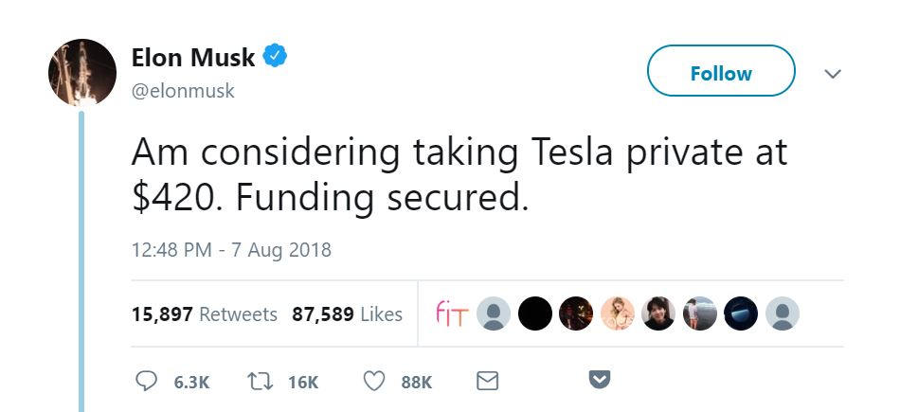

GET /tweets
200
OK
Notes:
Or it might come back with your requested tweets. Either way, there are four important parts here, and a few less important parts we haven’t shown yet:
the method
the url
the response code
the response body, which is optional
Let’s talk about each of these in turn.

Slide 15
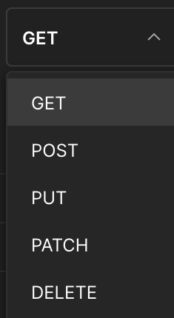
HTTP
Methods
Notes:
The first part of the request is the method. In Postman, you can change the method using this handy dropdown. There are more methods than I’ve shown here, but these 5 are the most used.
GET requests are exactly what they sound like. You’re asking the server to get you something. In our previous example it was tweets, but it could be anything: HTML, an image, a video, an excel spreadsheet. GET requests do not modify, they only retrieve.
POST requests are to create things. You can think of them like sending a letter to an Etsy seller. The letter has things inside it that tell the seller how to create the thing you want.
PUT requests are to replace things. This is how I’ve almost always seen updates done in Cerner APIs. You GET the whole thing whatever it is, make your changes, and PUT the new state back to the server.
PATCH requests are to make smaller changes. Some of the API resources we use are very large. For example, in my application, we have data models that contain data sets that contain fields. If you just want to update the data model’s name, it doesn’t make sense to send the whole nested structure back over the wire. PATCH lets you send back the changed name and update only that.
DELETE requests are self-explanatory. You tell the server which thing you want gone, and it deletes it for you.

Slide 16
The
URL
Notes:
The second part of a request is the URL or Uniform Resource Locator. You may also hear this called an Address, URI, or Route. Given the number of postal terms we use, I think you can see why this app is called Postman.
Interestingly, the URL is the only part of a request that non-technical people know and understand. The most basic URLs are like this one. They have a protocol and a domain name.

Slide 17
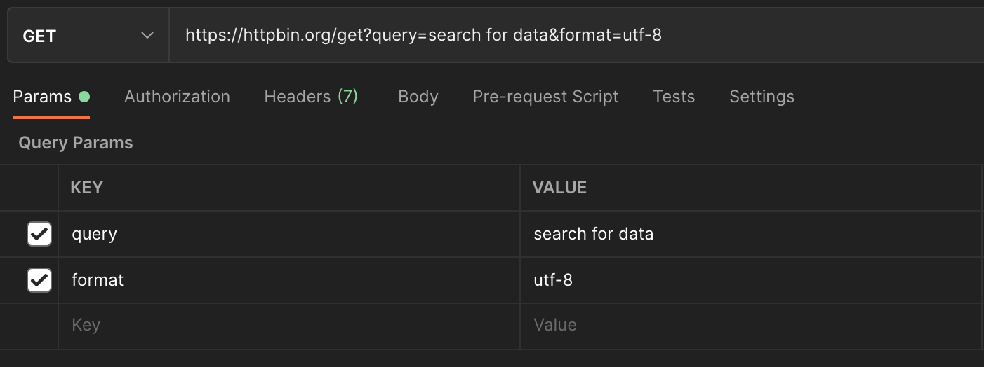
Protocol
Domain
Path
Query Parameters
Notes:
But URLs can certainly be more advanced. Let’s take a look at another one. This is making a more interesting request. We still have a protocol and domain, as before, but now we also have a path and two query parameters.
The path or endpoint of a request tells the web server which resource to look up. Here we’re going to the resource at /get, but you’ll often see APIs expressed like /core/v1/tenants, which says we’re looking up tenants in the Core API version 1.
I’m sure you’re looking at this screenshot and wondering what the other tabs do, so let’s quickly go over them:

Slide 18
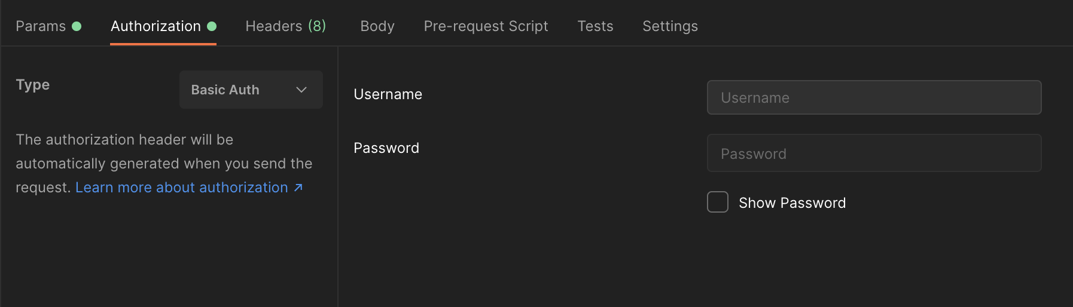
Authorization
Notes:
Authorization is how you avoid getting those dreaded 401 unauthorized errors. You can provide a username and password, a boatload of information for OAuth 1, a single token for OAuth 2, or a couple other types that aren’t used much around here.

Slide 19
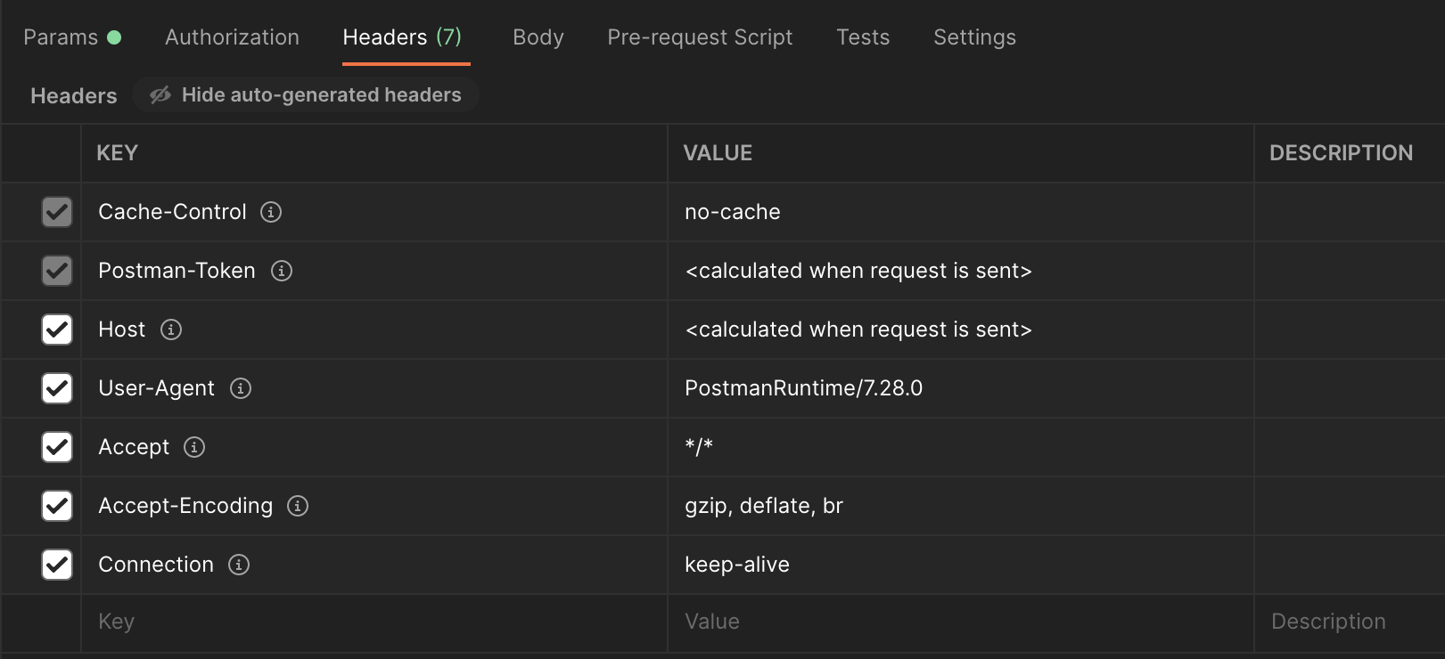
Headers
Notes:
Headers are kind of like the invisible settings of a request. They tell the server things about you, the client. They also let the server know what you want back. Here, it says don’t give me a cached response, but I’ll accept any file type, even if it’s zipped up, and don’t close our connection after this first request.

Slide 20
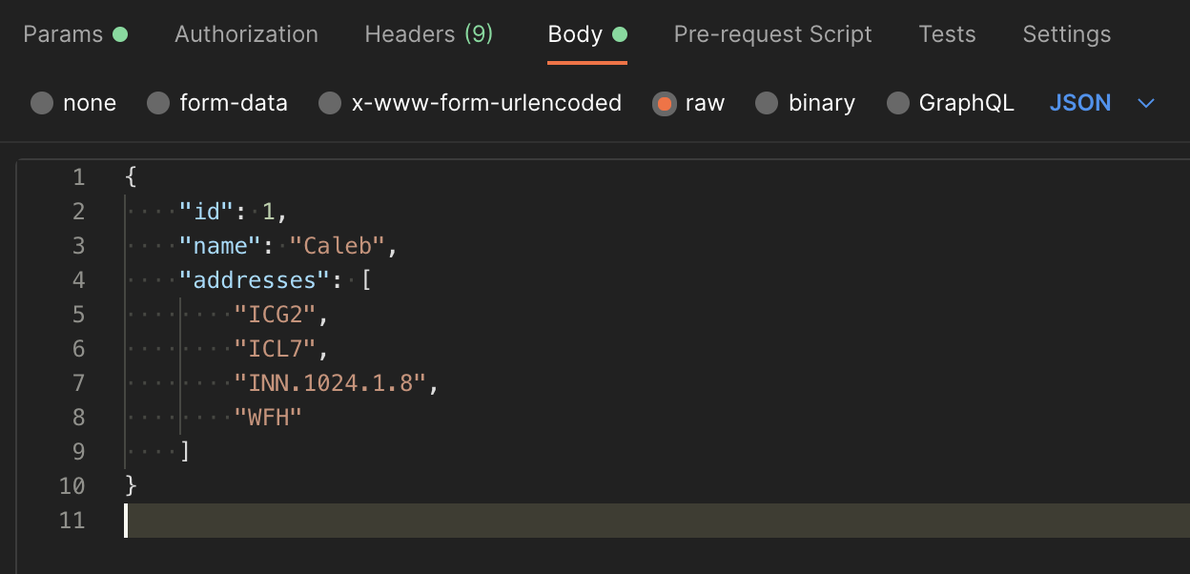
Body
Notes:
The body of a request is only needed for the P methods: POST, PUT, and PATCH. Most of our Cerner APIs only accept JSON, but in the wider world, you’ll see form submits that are key value pairs and even the occasional XML.
The last three tabs here will be important to us later. The pre-request script is some Javascript that can read and change any part of your request. The Tests could and maybe should have been labeled the Post Request script. They can read and do things with any part of your request or the response. Settings lets you change how redirects and auth are handled, among other things.
And now, the moment you’ve all been waiting for…

Slide 21

Notes:
Let’s press the Big Blue Button

Slide 22
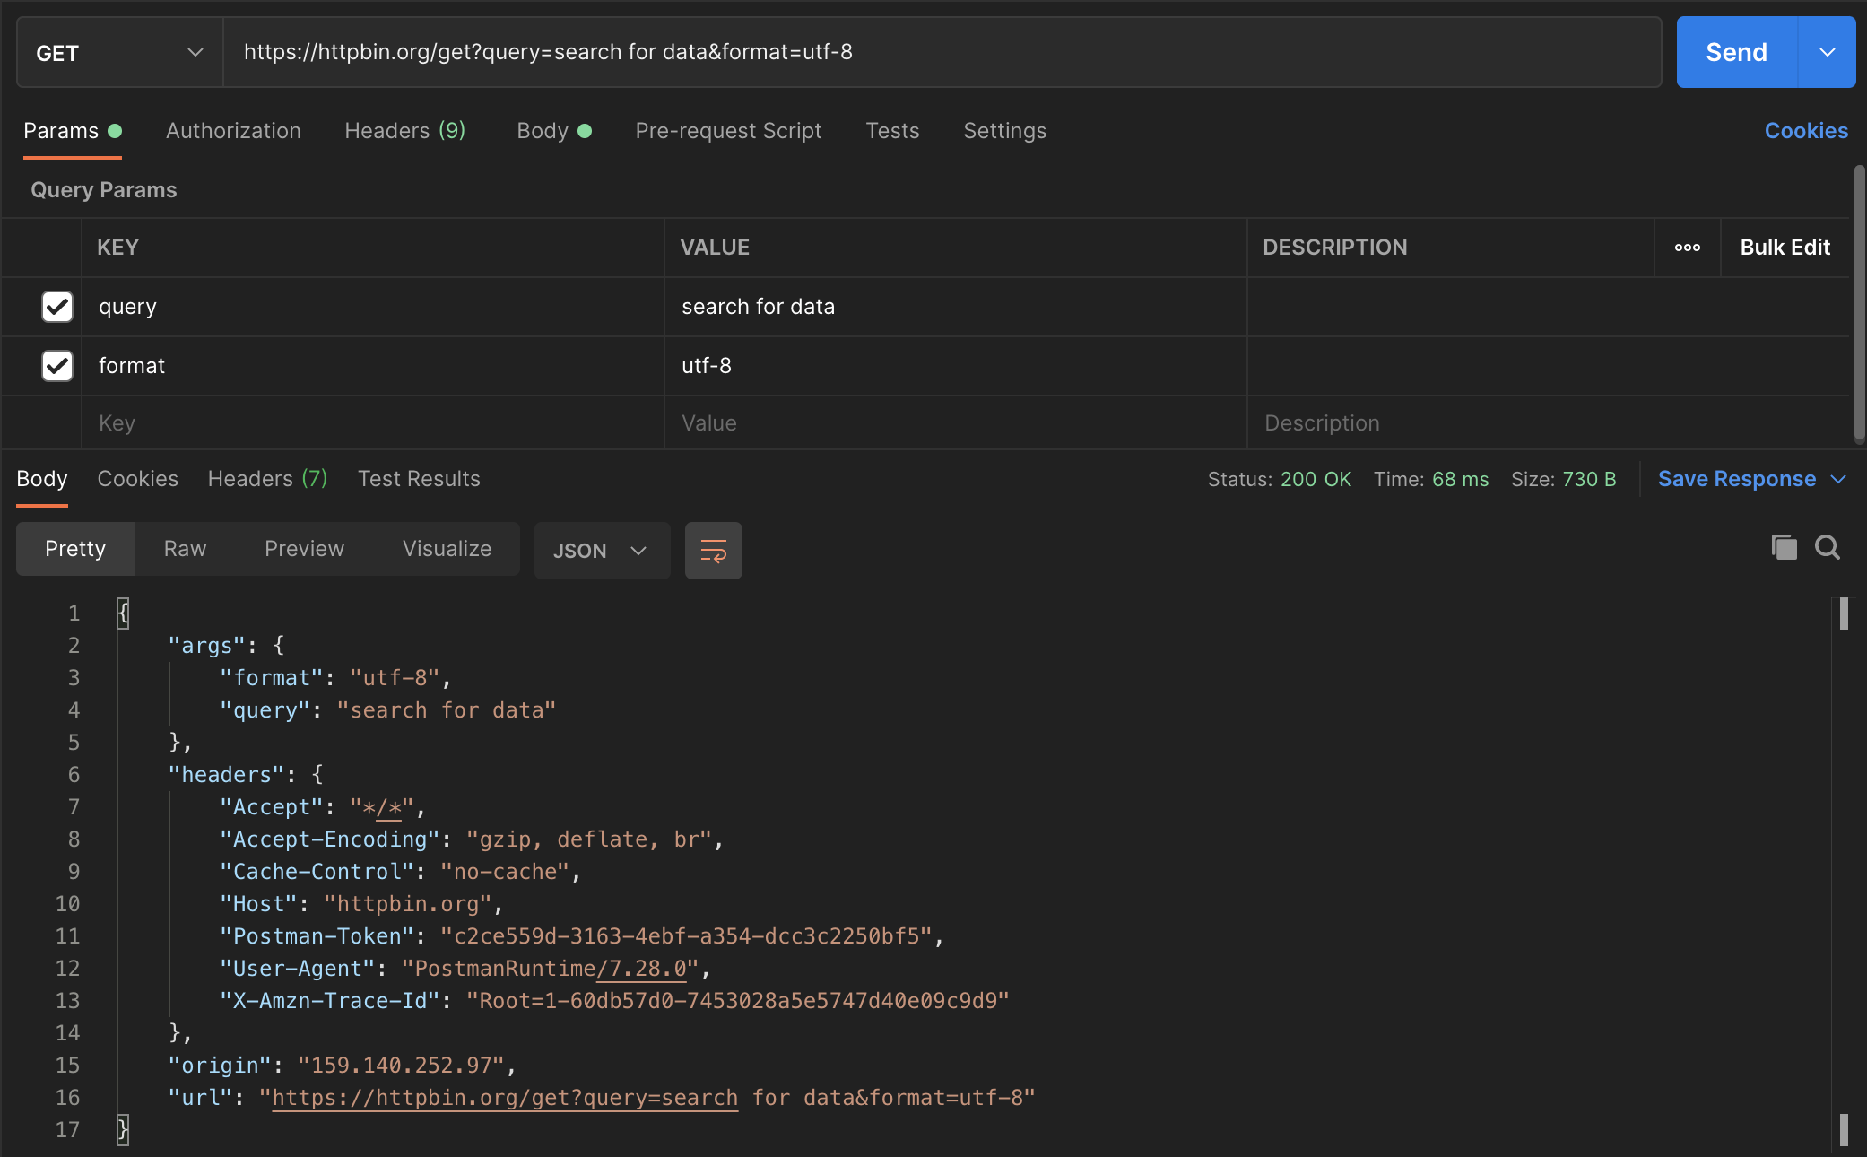
Get a Response
Make a Request
Notes:
When you press the button, the bottom half of your window populates. That section is reserved for the response. It can be a lot of information, so let’s break it down.
Taking up the biggest part is the response body.
The pretty tab shows JSON, XML, and other structured formats pretty printed and syntax highlighted.
Raw shows you just the text (or the bytes) of the response.
Preview shows you rendered html.
Visualize is an advanced feature that lets you supply a handlebars html template and use the response data to fill it out. This lets you see charts and graphs. I’ve never seen anyone use it, because if you’re making charts and graphs, you should upgrade to a full-on webpage.
Over on the right, you can see the response time and how many bytes were returned. You can also save the response to a file. And finally, you can see the fourth major part of an http request and response we mentioned earlier, the response status code.

Slide 23
302 Found
100 Continue
Response
Status
Codes
400 Bad Request
504 Gateway Timeout
204 No Content
201 Created
404 Not Found
503 Service Unavailable
401 Unauthorized
500 Internal Server Error
200 OK
Notes:
I will admit I have to look up all but the most used of these status codes every time. I like MDN or httpstatuses.com for them. You don’t need to memorize these, and there’s lots more than I’m showing here, including the very important 418 “I’m a teapot” code.
Fortunately, they’re categorized by their hundreds place.
The 100s are all informational statuses. I’ve never seen one because they’re mostly used for low level plumbing.
The 200s are all the success codes. 204 No Content means you don’t have to look at the response body, because it’ll be empty. It’s typically used for Updates and Deletes.
The 300s are all the ”wrong number” codes. 302 Found responses include a header called Location that you’re intended to visit instead of whatever you asked for, and browsers will automatically redirect you.
The 400s are the “you done messed up, A-A-Ron!” codes. It means something the client did was wrong, and you shouldn’t send that request again without changing it somehow.
The 500s are the “Oops” codes. It means the server is having some kind of trouble that prevented it from fulfilling your request.

Slide 24
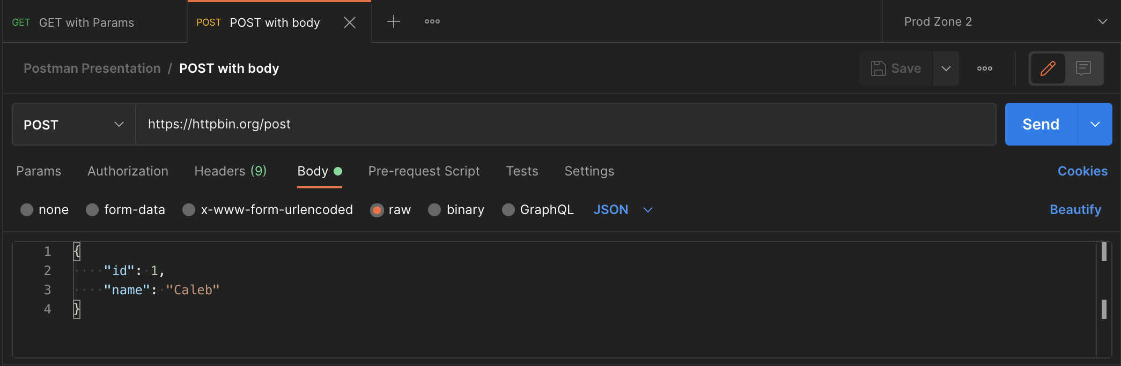
Tabs
Notes:
Okay, so you’ve made your first request, gotten your tweet back, and… crap.
It’s got a typo. Now you need another request to fix it. Good thing postman has tabs! So, you open up a new tab. And another. And another.

Slide 25
Tabs
Notes:
What do you mean I have too many tabs open? I can sort of read what they all say… Oh crap, did I close that one? I wanted to save it!
Good thing postman has my back.

Slide 26
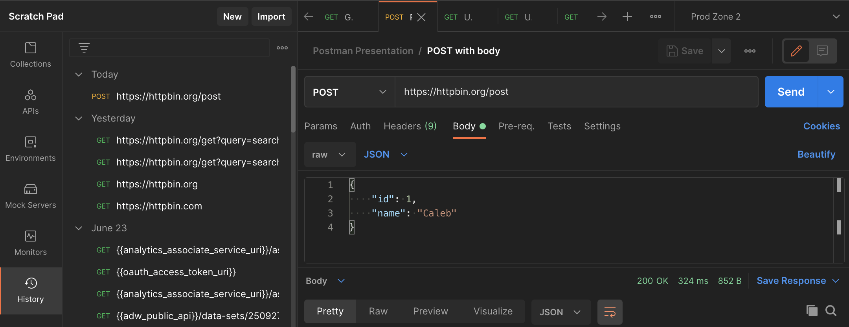
History
Notes:
Postman keeps a history of every request you make, so it’s easy to recall older requests. But if you make a certain request or set of requests a lot, it’s time to turn to collections.

Slide 27
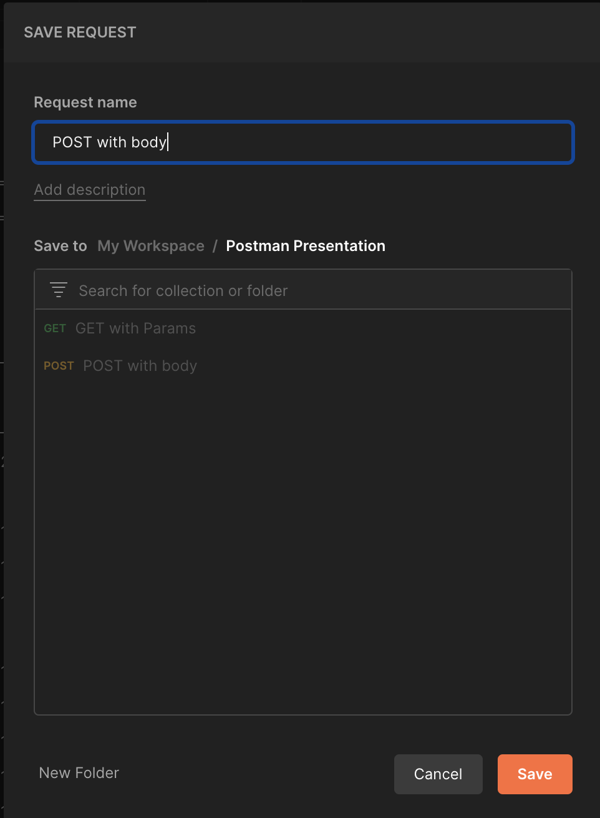
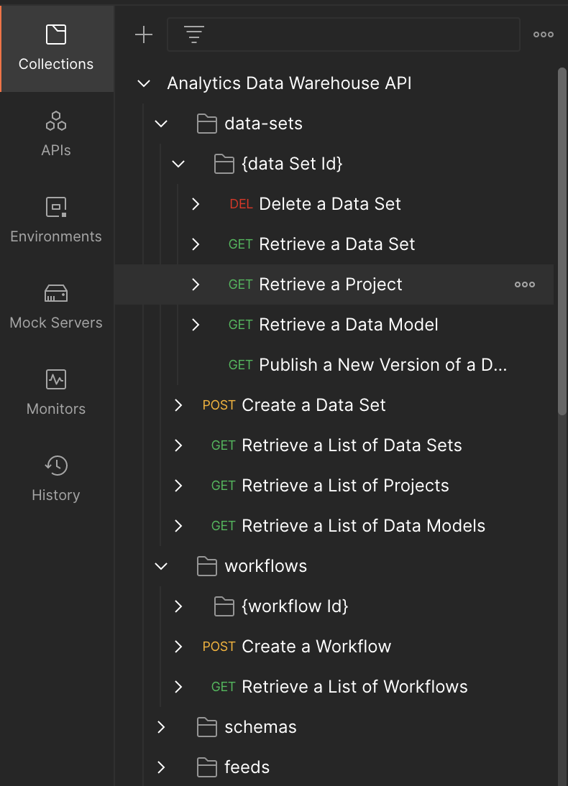
Save
a
Request
To
a
Collection
Notes:
Postman lets you save requests, and group multiple saved requests into a collection. Collections can have folders, which means you can get as many layers of nesting as you need.

Slide 28
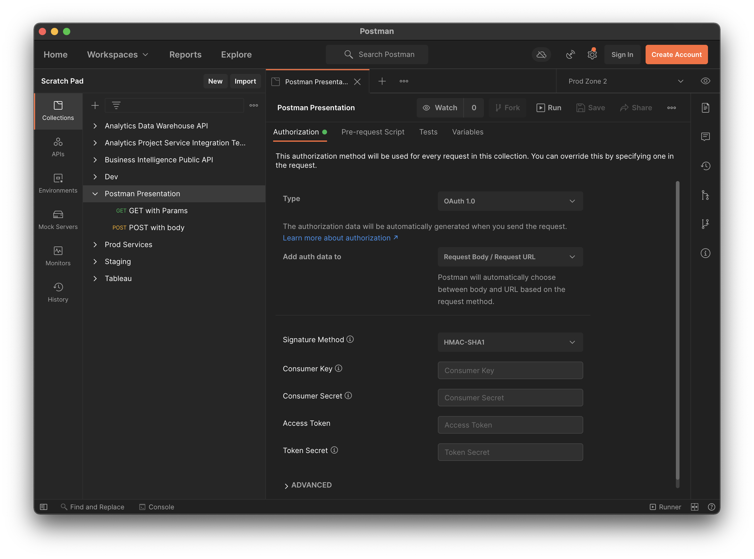

Authorize
All the Things!
Notes:
It gets even better though. Collections also let you define things for the entire collection, like a default authorization scheme. Remember this, because it will be important when we get to the advanced section!

Slide 29
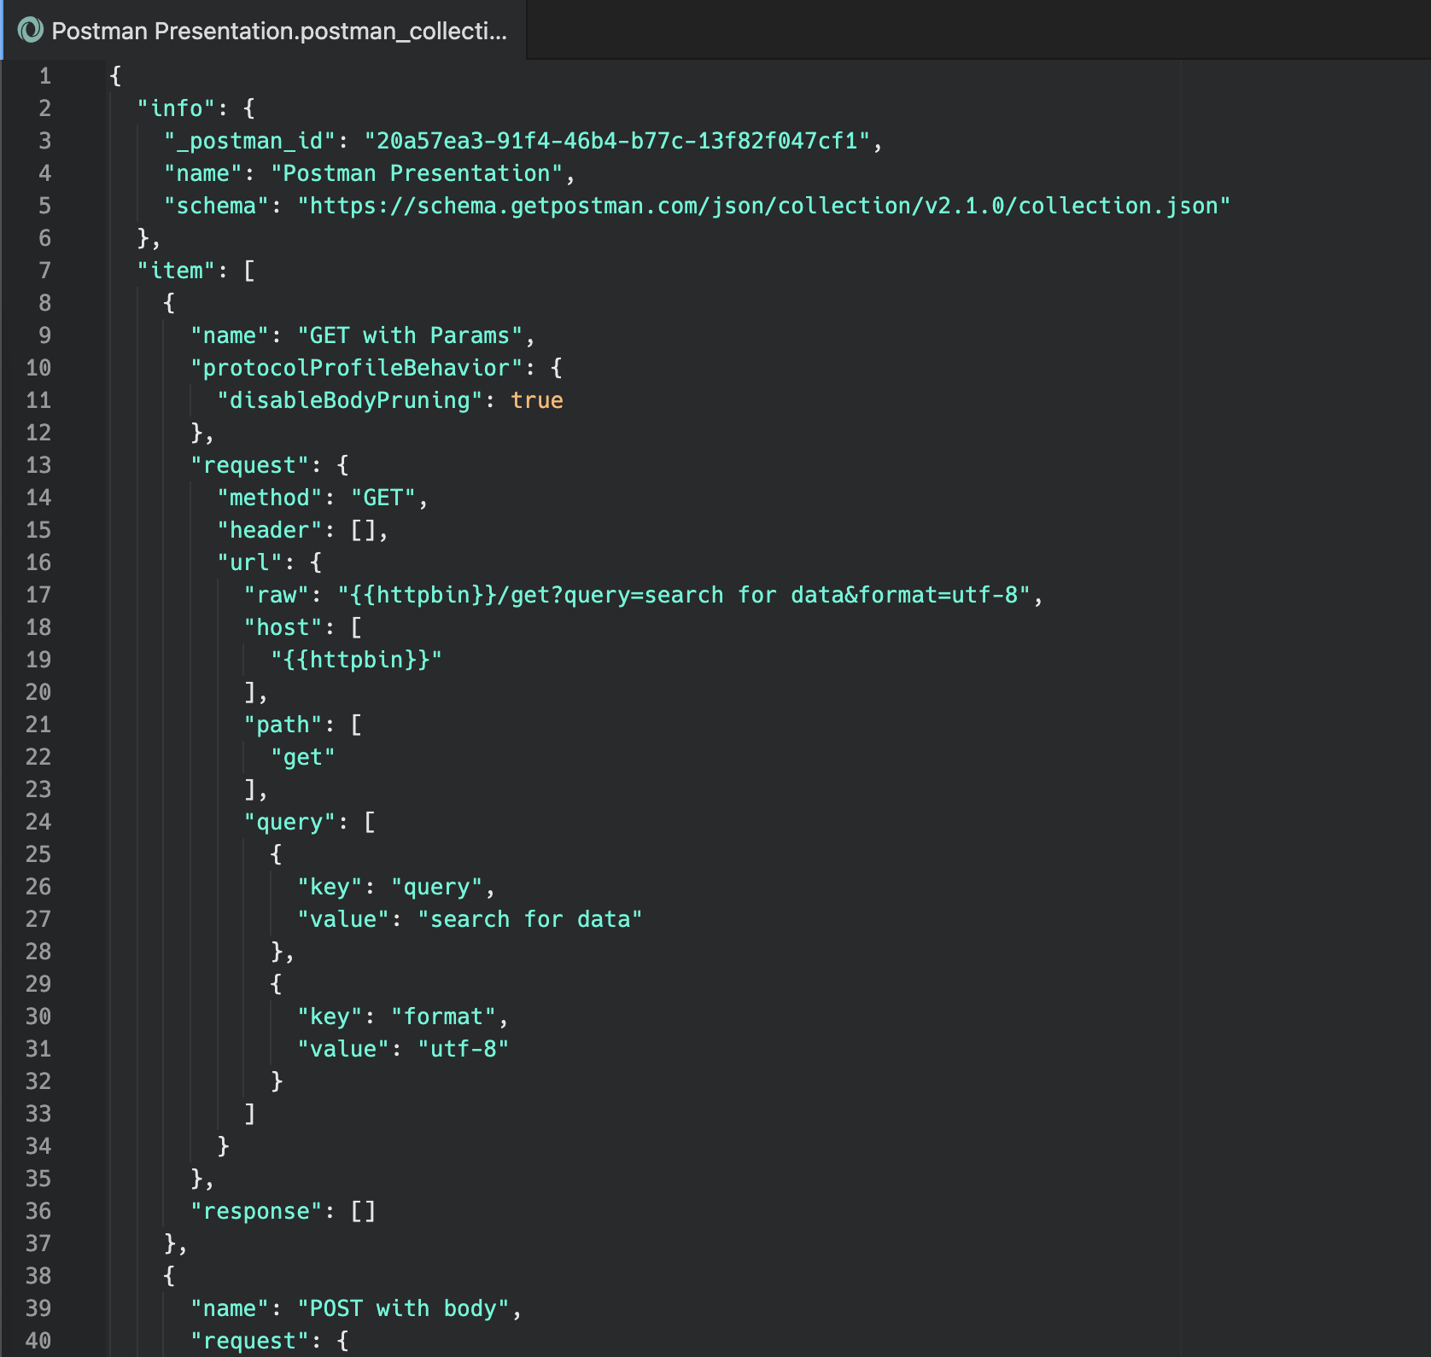
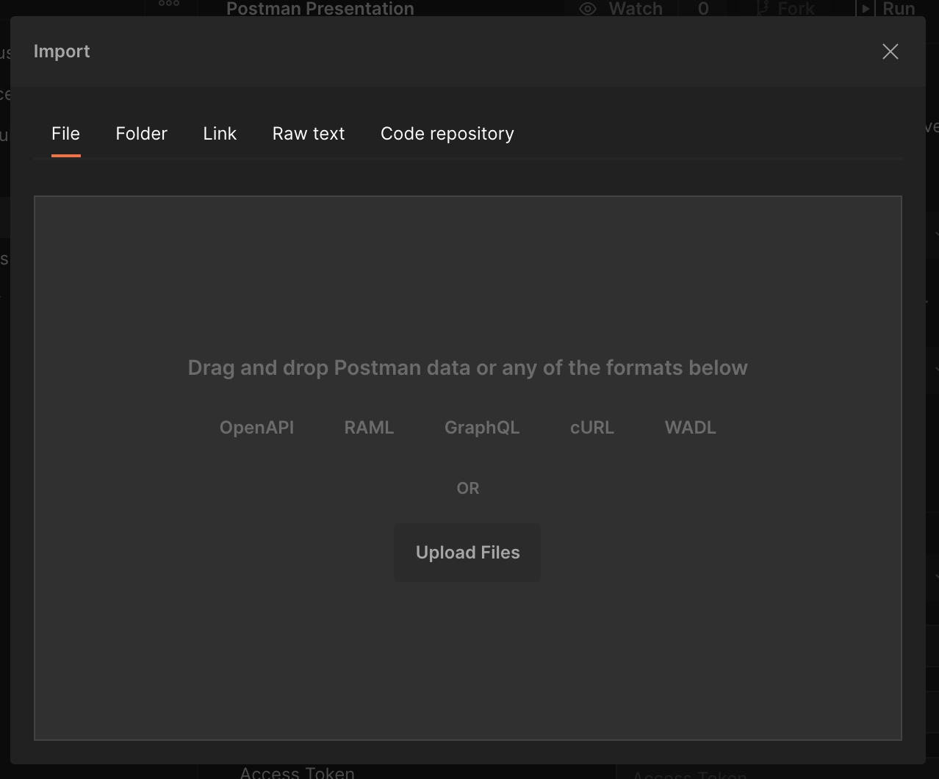
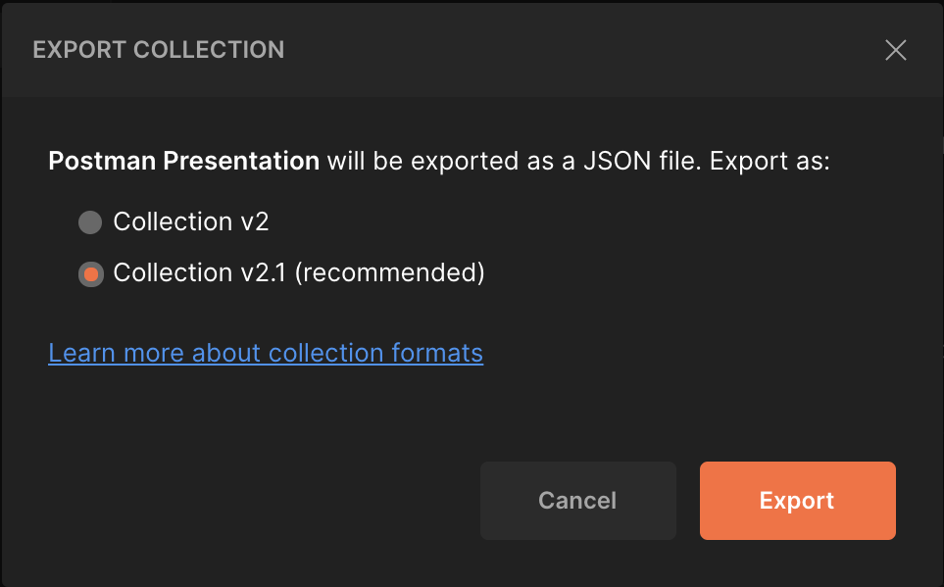
Notes:
Did I say it gets even better? Because it gets still better than that. You can import and export collections to JSON files. That makes them super easy to share around. I even have a github repository called postman collections with all the collections I’ve put together for Analytics.

Slide 30
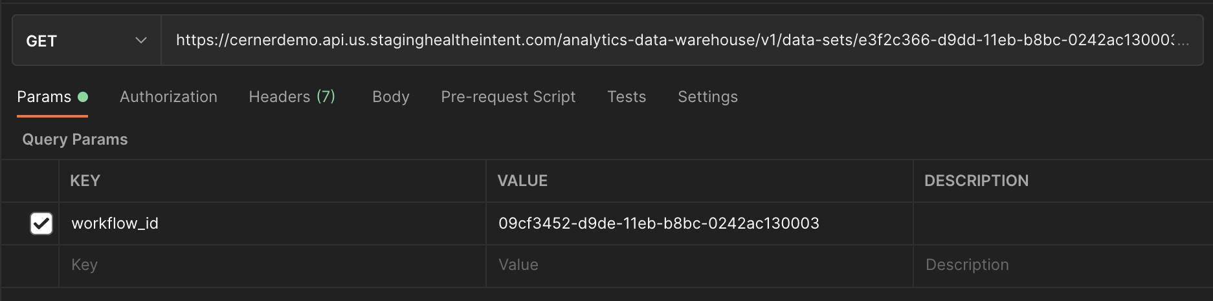
This is a lot to
copy and paste
Notes:
Okay, so we’ve got this HTTP thing down, made a few requests, put them into a collection, what’s next? Well, it’s getting really annoying having to copy paste these long public API URLs around everywhere. It sure would be nice if we could store them somewhere and refer to them.

Slide 31
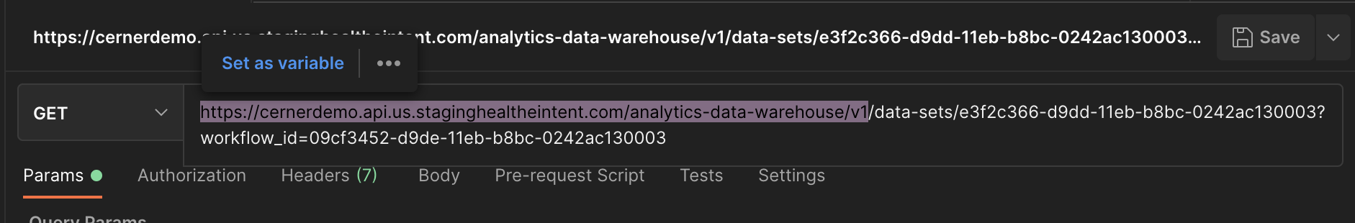
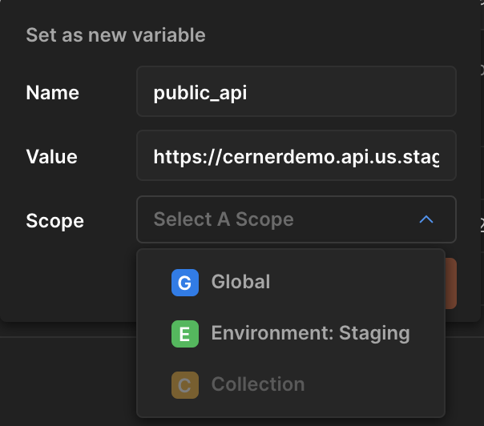
Saving a
Variable
Notes:
Let’s see, if I highlight that base domain… what’s this? Set as variable? And I can scope it globally, or to my collection, or to… an environment? What’s an environment?

Slide 32
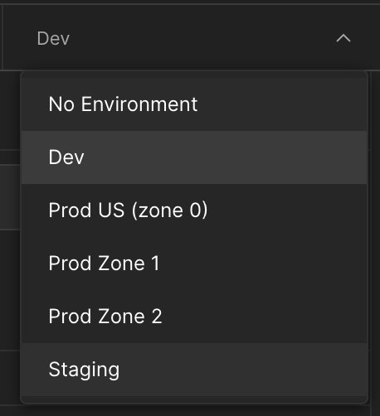
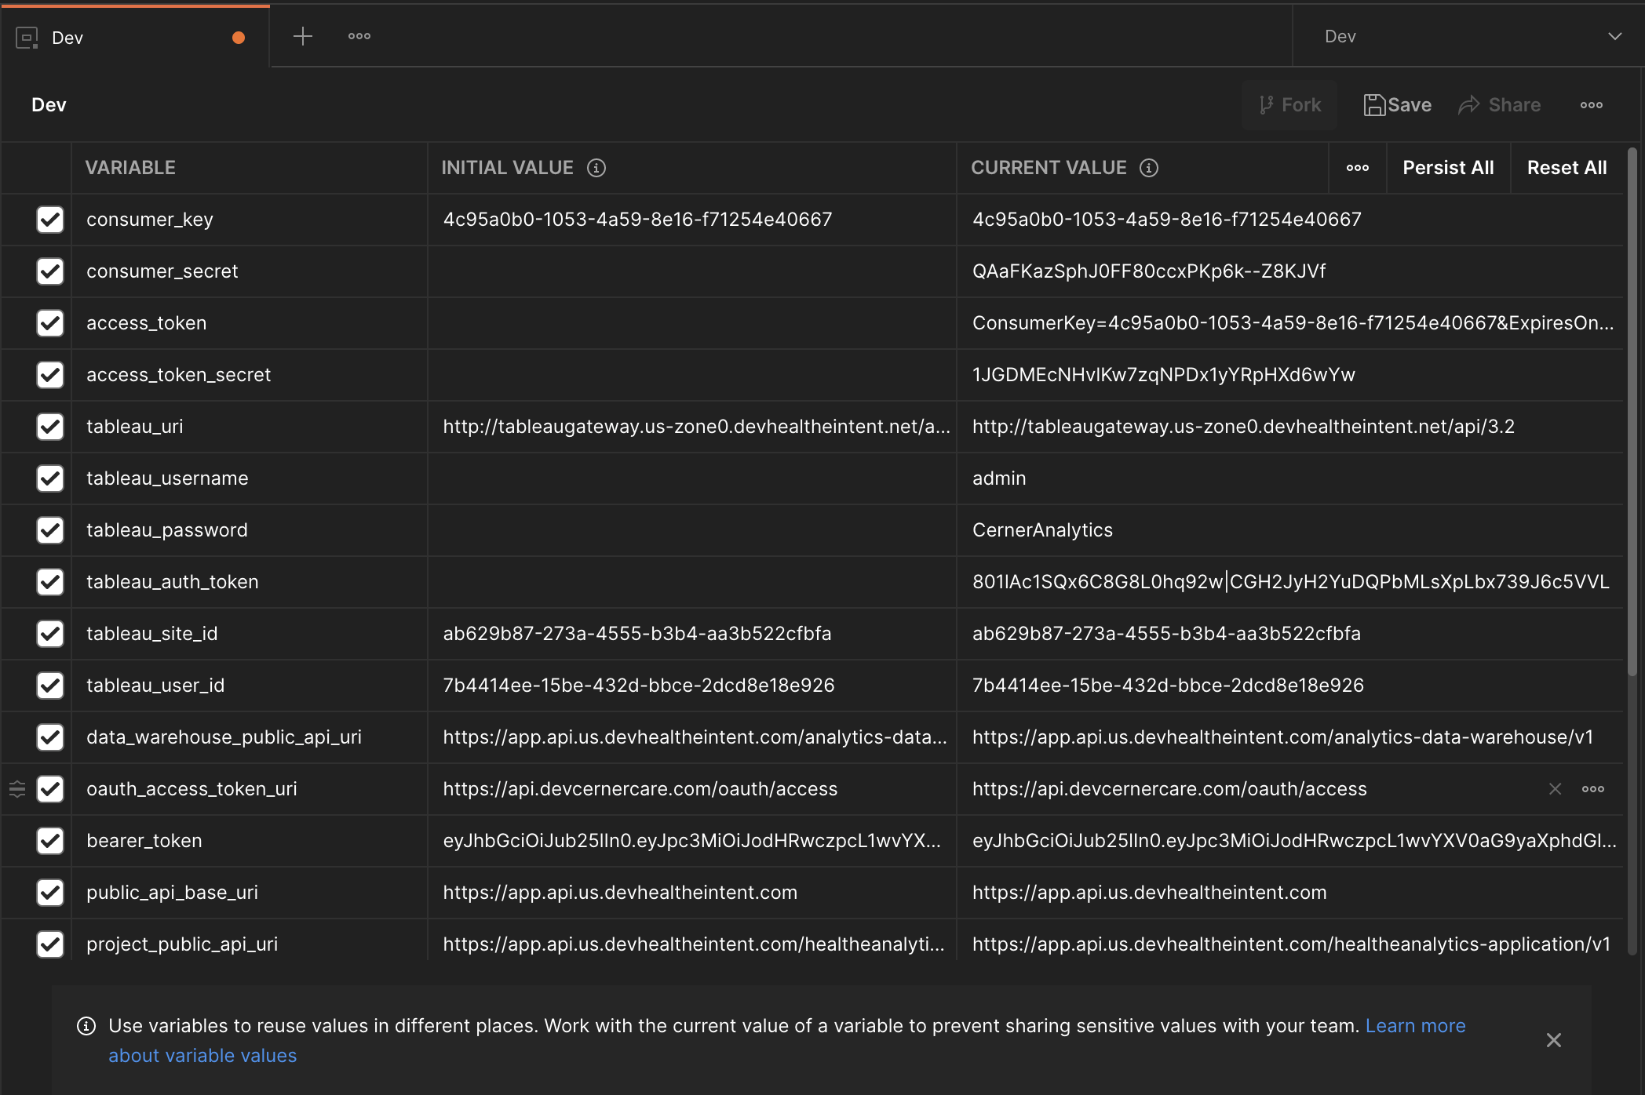
Environments
Redacted
Redacted
Redacted
Redacted
Notes:
Environments give our collections superpowers. With an environment set up for development, staging, and all the various productions we deploy to, you can have a single variable that means different things depending on what environment you’re in. That public_api_base_uri can point to the correct place no matter which environment you’re in.
You’ll probably notice that all these environment variables have an initial and a current value. That’s because environments can be exported too, and you don’t want to put your production secrets in plaintext when you share your environments with a friend. The current value is what postman uses; the initial value is what gets exported. They’re the same unless you make them different.

Slide 33
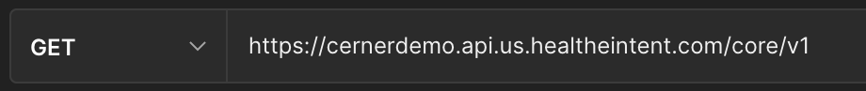


Notes:
There’s one more problem with this big URL. I work in HealtheIntent, and our production zones each have a whole lot of tenants. For most of our older services, you pass in a tenant id to every call if you want it scoped to a tenant. But for the new public and protected apis, tenant is built into the domain. cernerdemo in this screenshot is part of the domain. You could put just the tenant mnemonic into a variable and change that variable, but that still leaves us with a long domain to type over and over.
Fortunately, postman supports variables inside variables. You can nest them as deep as you need to. Here we can put the tenant mnemonic in the variable for the public api base uri

Slide 34
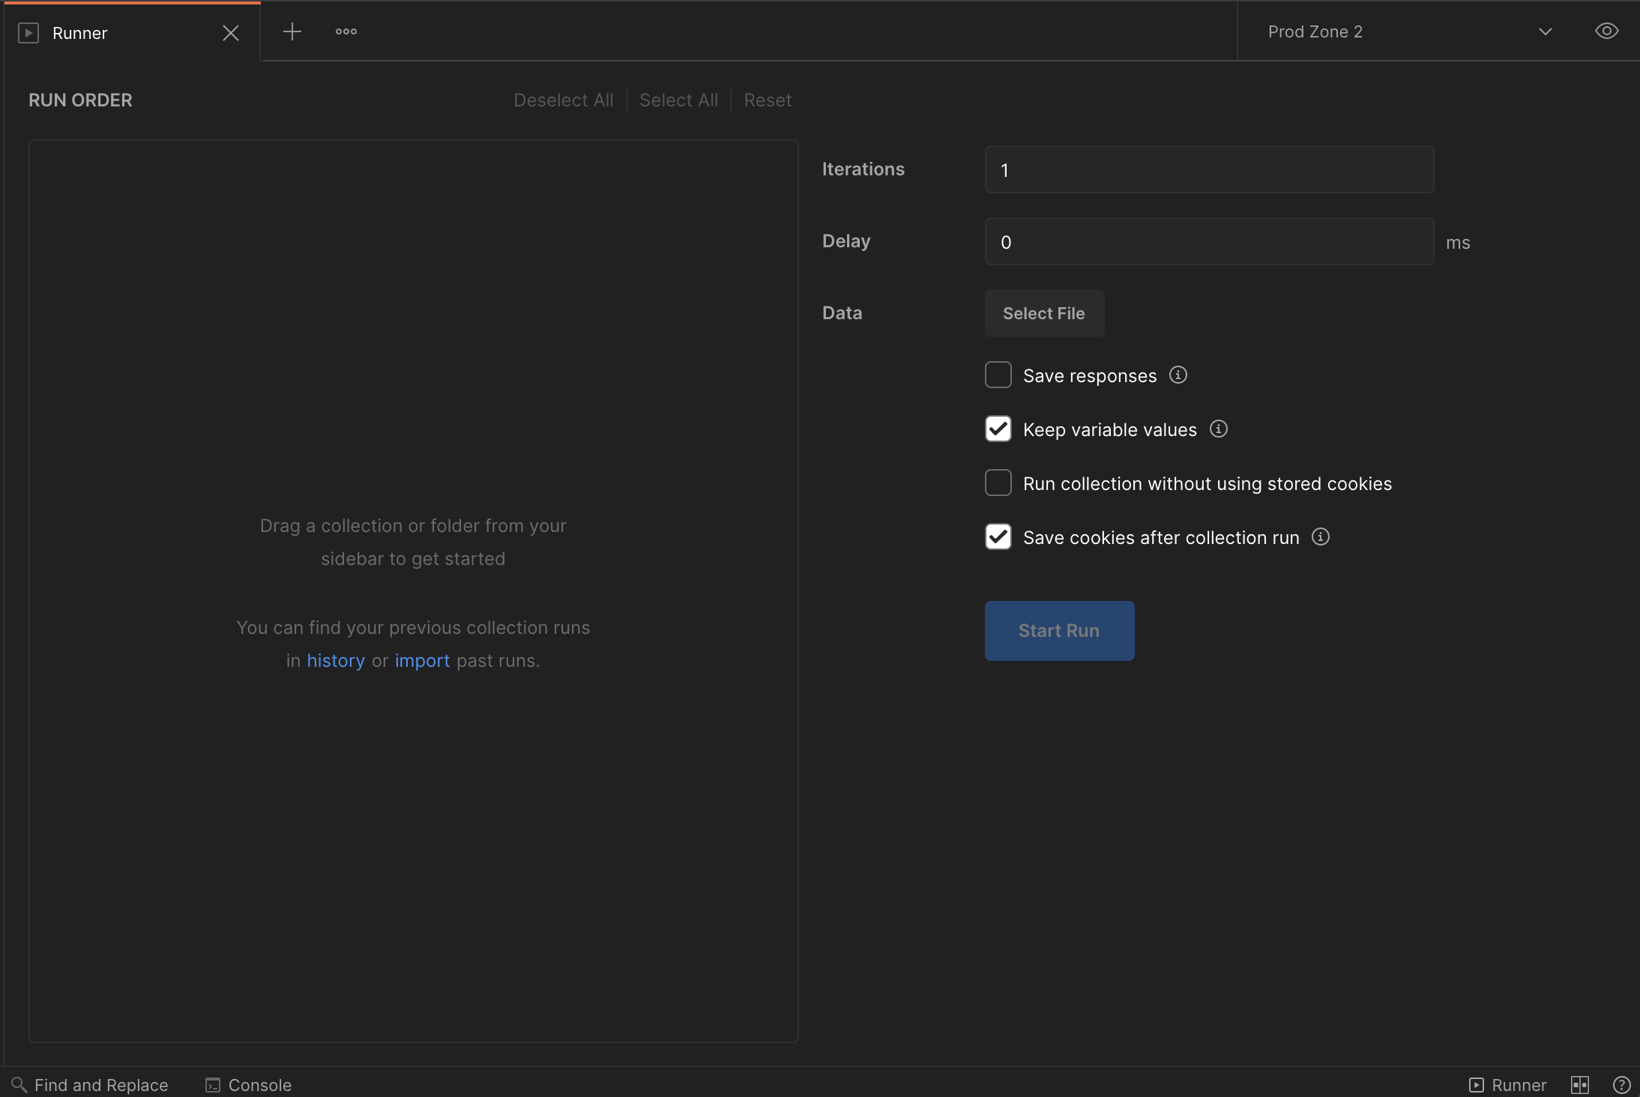
Testing with the Runner
Notes:
Okay, so our collection is variabled up. We’ve got 200 requests in there, and it’s super easy to run them one by one. You could use them as a nearly automated integration test. But this is DevCon, not QuitterCon. We don’t settle for nearly automated. And neither does postman. We’ve done enough walking, it’s time to run!
You see that little status bar item in the bottom right corner that says “Runner”? If you click it, you get this screen.

Slide 35
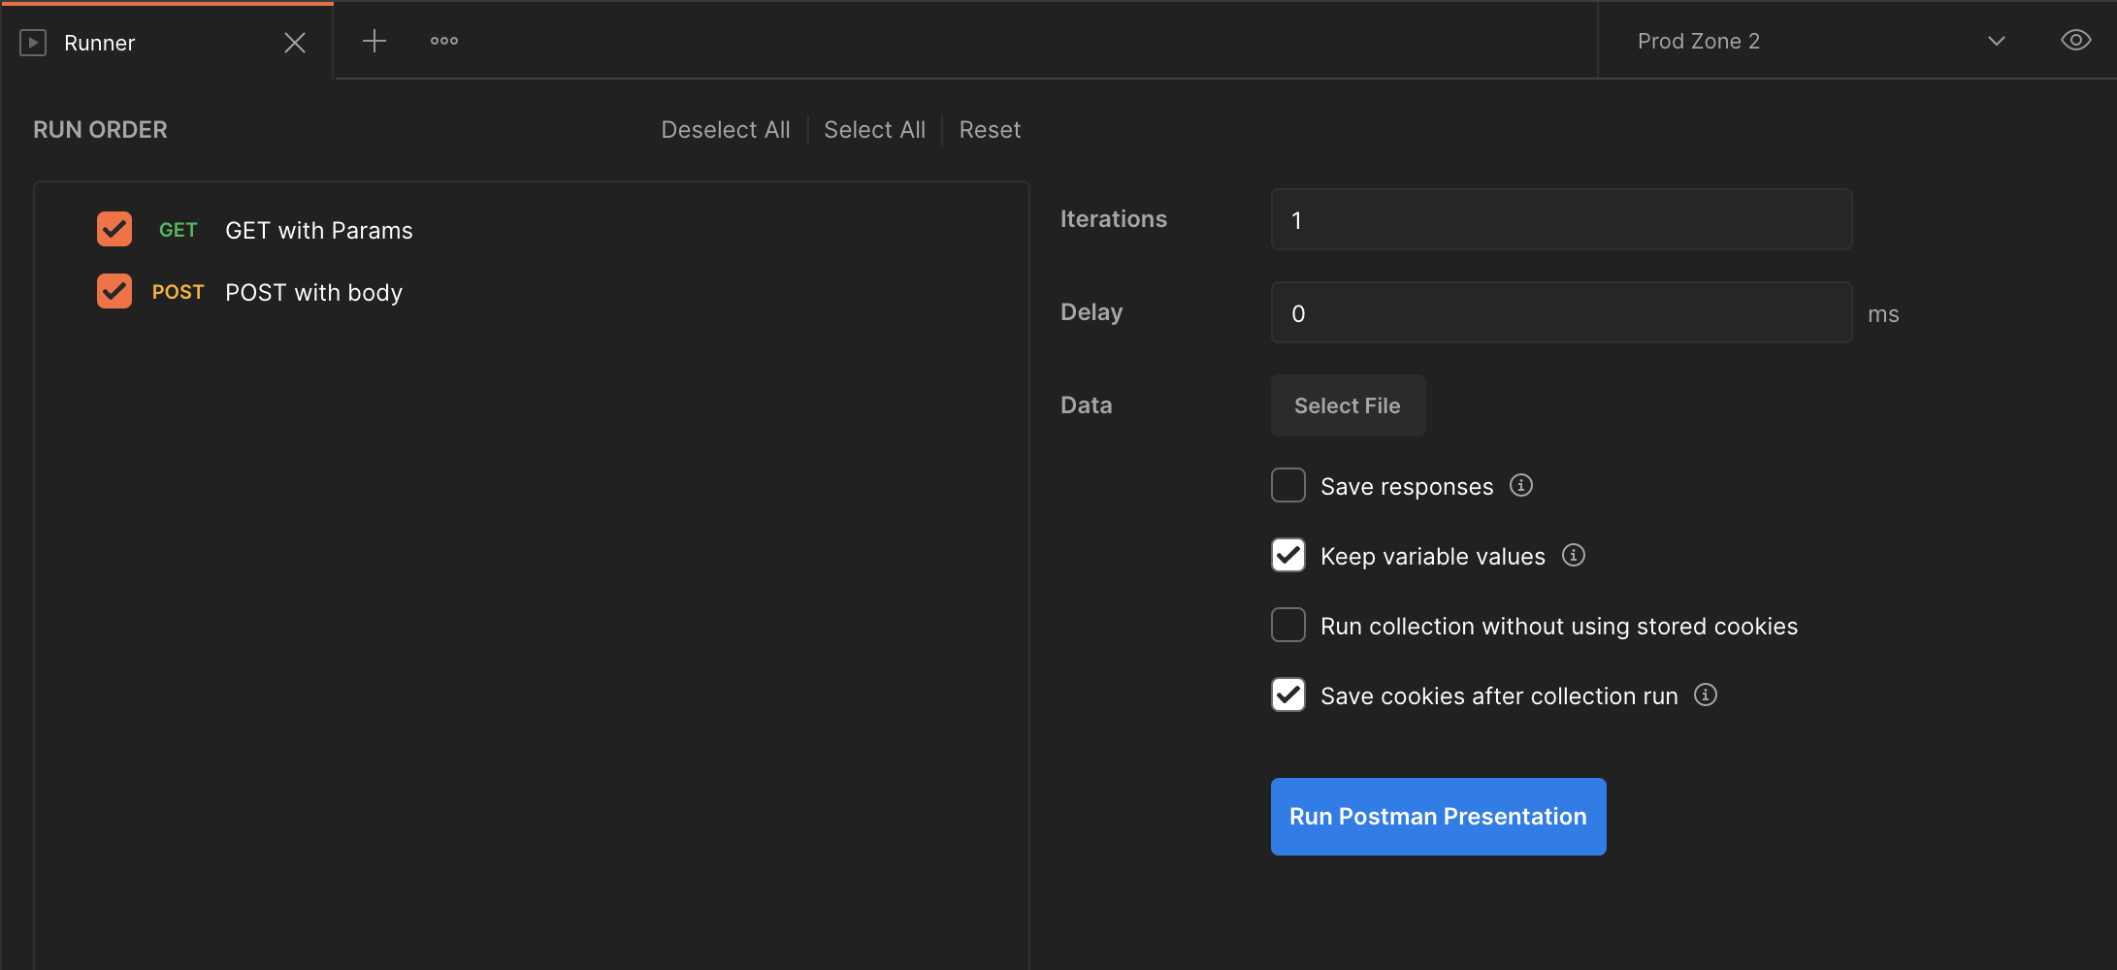
Add a Collection…
Notes:
Add a collection and you’re off to the races. Just press that Run button.

Slide 36
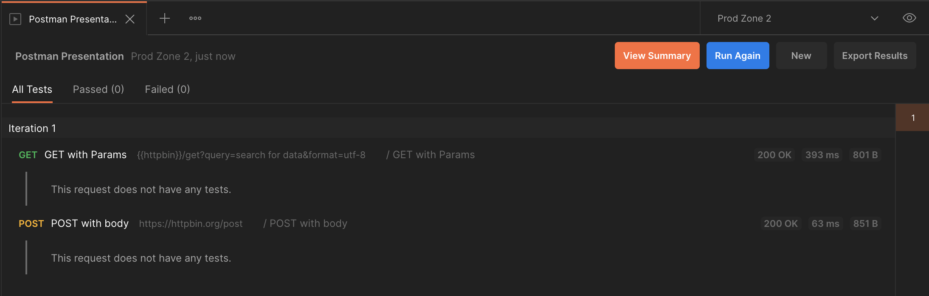
…and press Run
There is no third step
Notes:
Boom. One click testing that took no time at all to set up, using the requests you already have from your manual testing.
But Caleb, that’s not automated testing. One click is still one click. I want to set this up in my continuous integration pipeline and never touch it again.

Slide 37
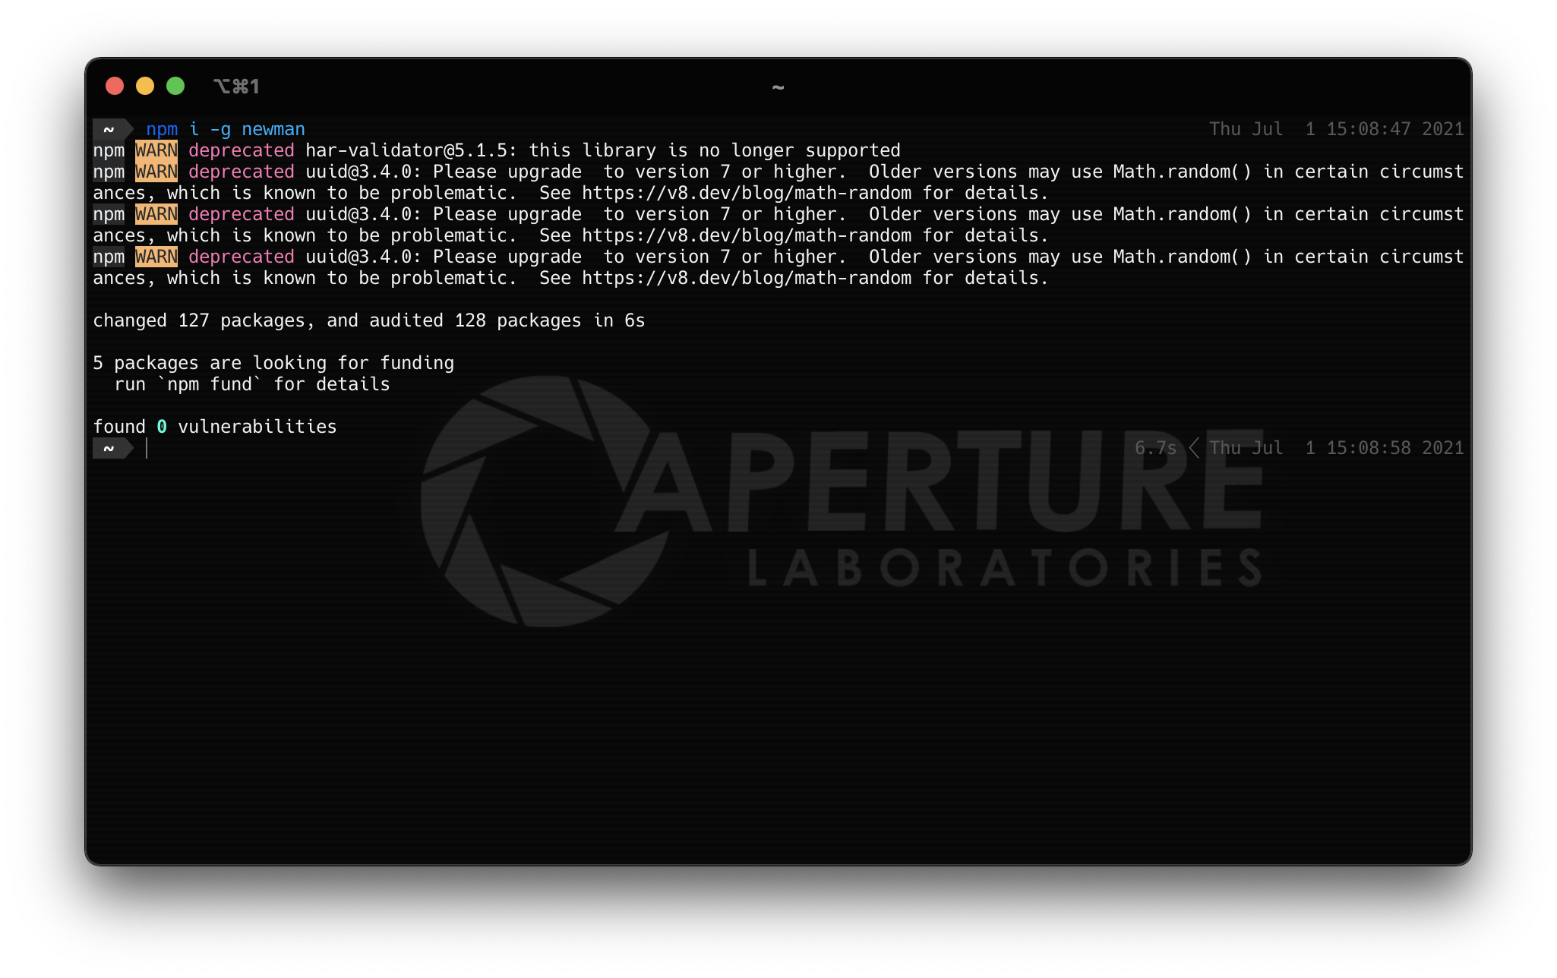

Notes:
Fair enough, I did promise you that we’d automate this. Do you have the node package manager yet? Odds are you do, and if not, node is easy to come by. Head over to nodejs.org and grab the Long-Term Support build. As of this presentation, that’s 14.17.2
Once you’ve got node, you’ve got npm. Run `npm i –g newman` at that terminal and grab the NPM package Newman. The `i` is for install, the hyphen g is for globally.

Slide 38
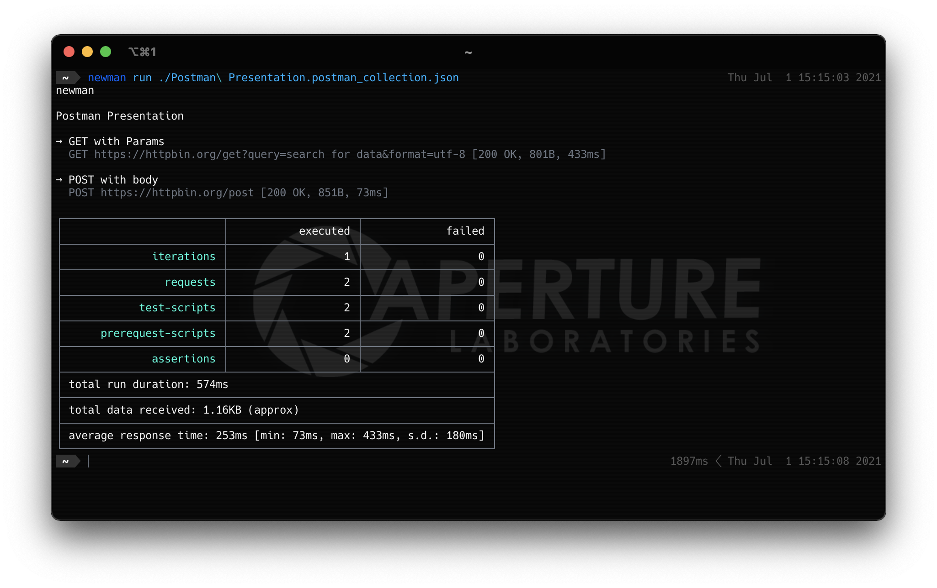
Notes:
Newman does what we just did in postman, but on the command line. It can print your results to the screen, it gives the correct response codes for CI, and it can even export your results as JSON if you want to write an integration like a github hook.

Slide 39
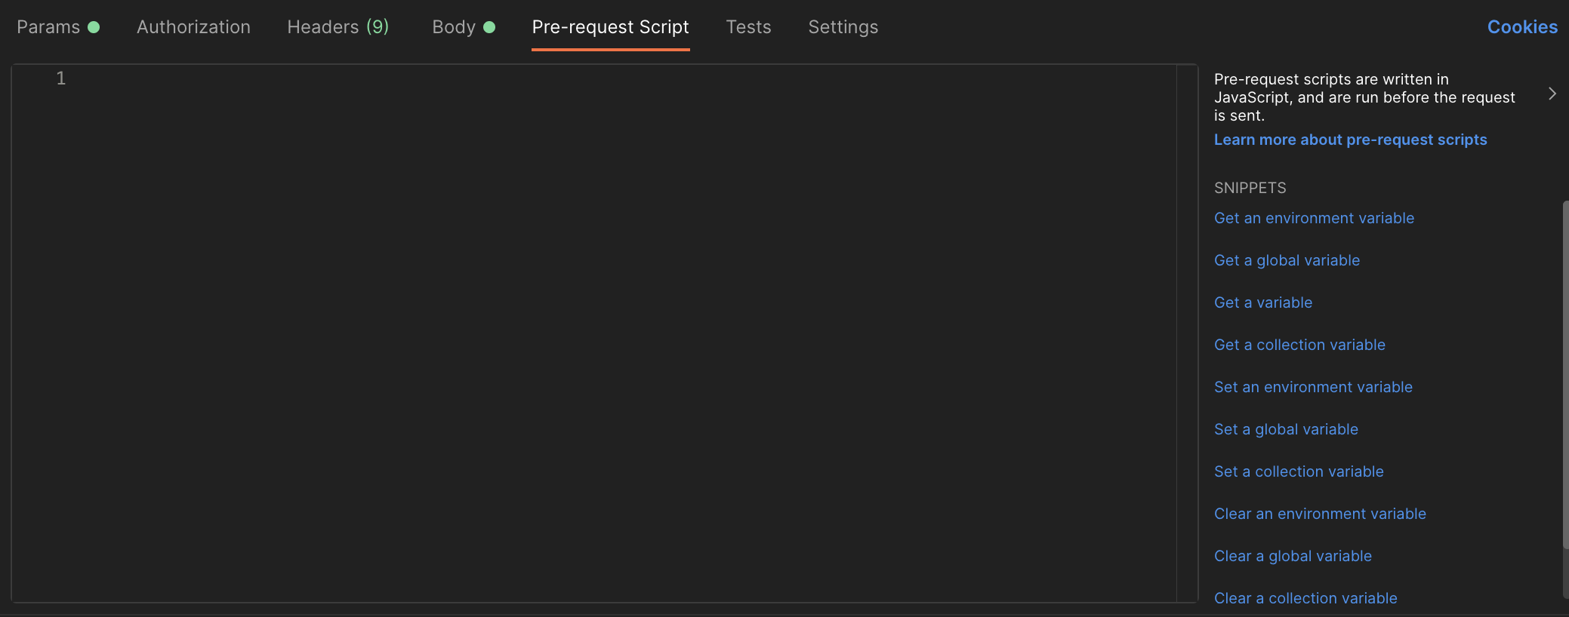

Notes:
Wow, that’s a lot of cool stuff you can do with postman. But we need to go deeper into the weeds. Do you remember those two tabs I said we’d talk about later, Pre-Request Scripts and Tests? Let’s see what we can do with the power of JavaScript!

Slide 40
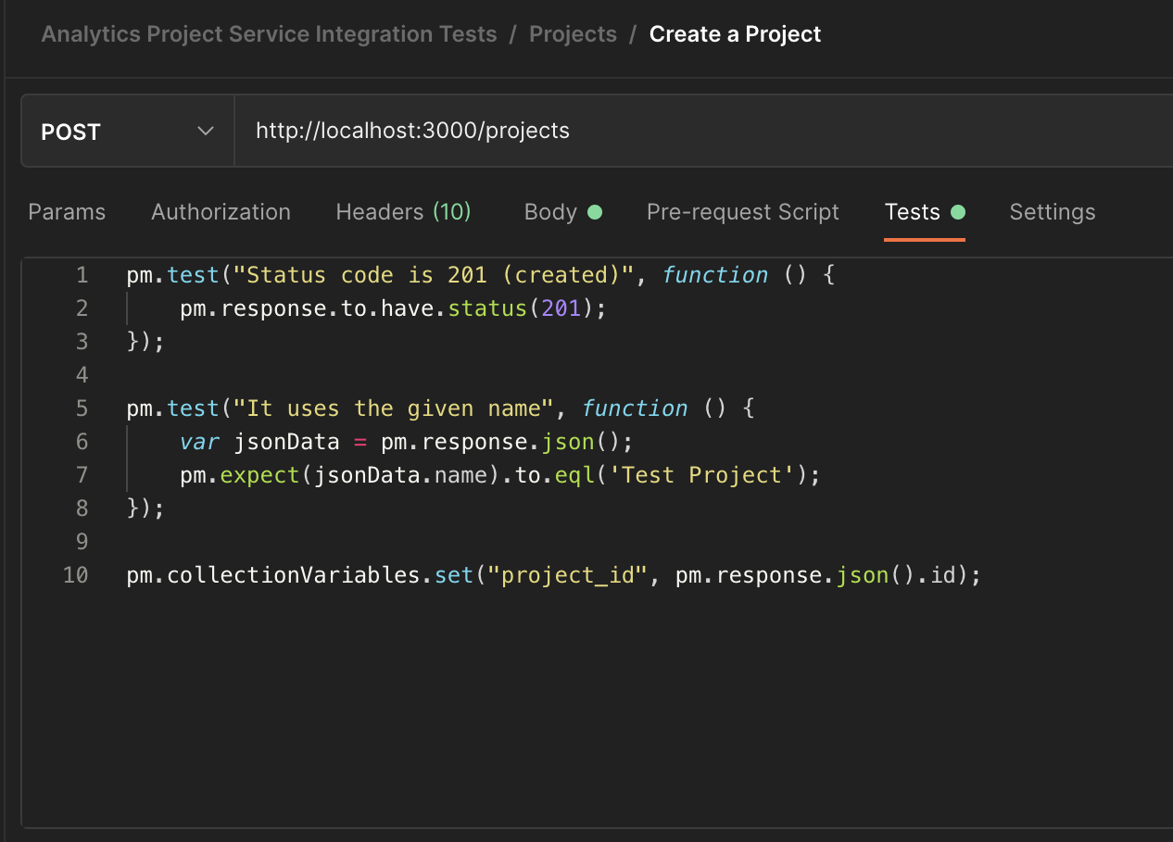
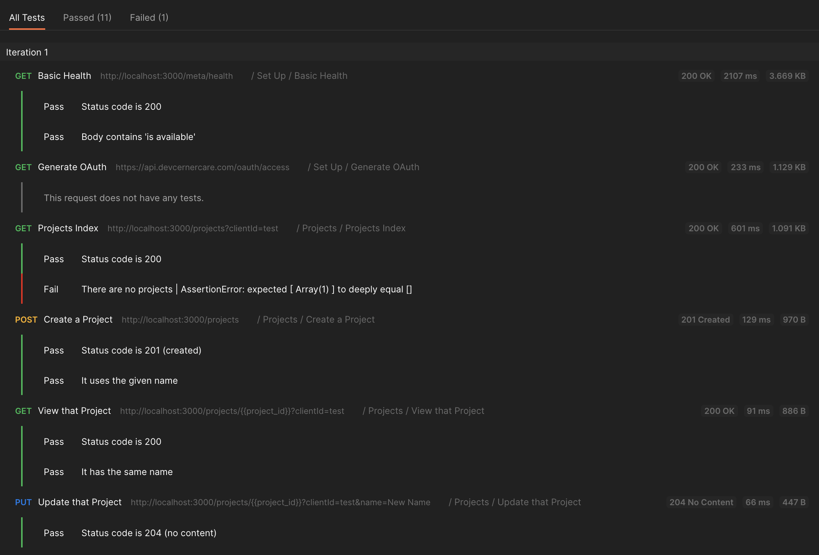
Notes:
The first thing we can do is write some actual tests. Our requests just running and not failing is good, but it would be nice to be able to test things like response codes, and what’s in the response body. Postman will let you do that in the Tests. Once you have them set up, you can run the collection and it will report back on your tests. This is a real integration test I started for our analytics project service.
You can see that Postman makes it easy to parse JSON. What you can’t see in these screenshots is the helpful snippets postman includes. If you want to test a status, all you have to do is click the “test status” snippet, and it will insert this first test for you.

Slide 41
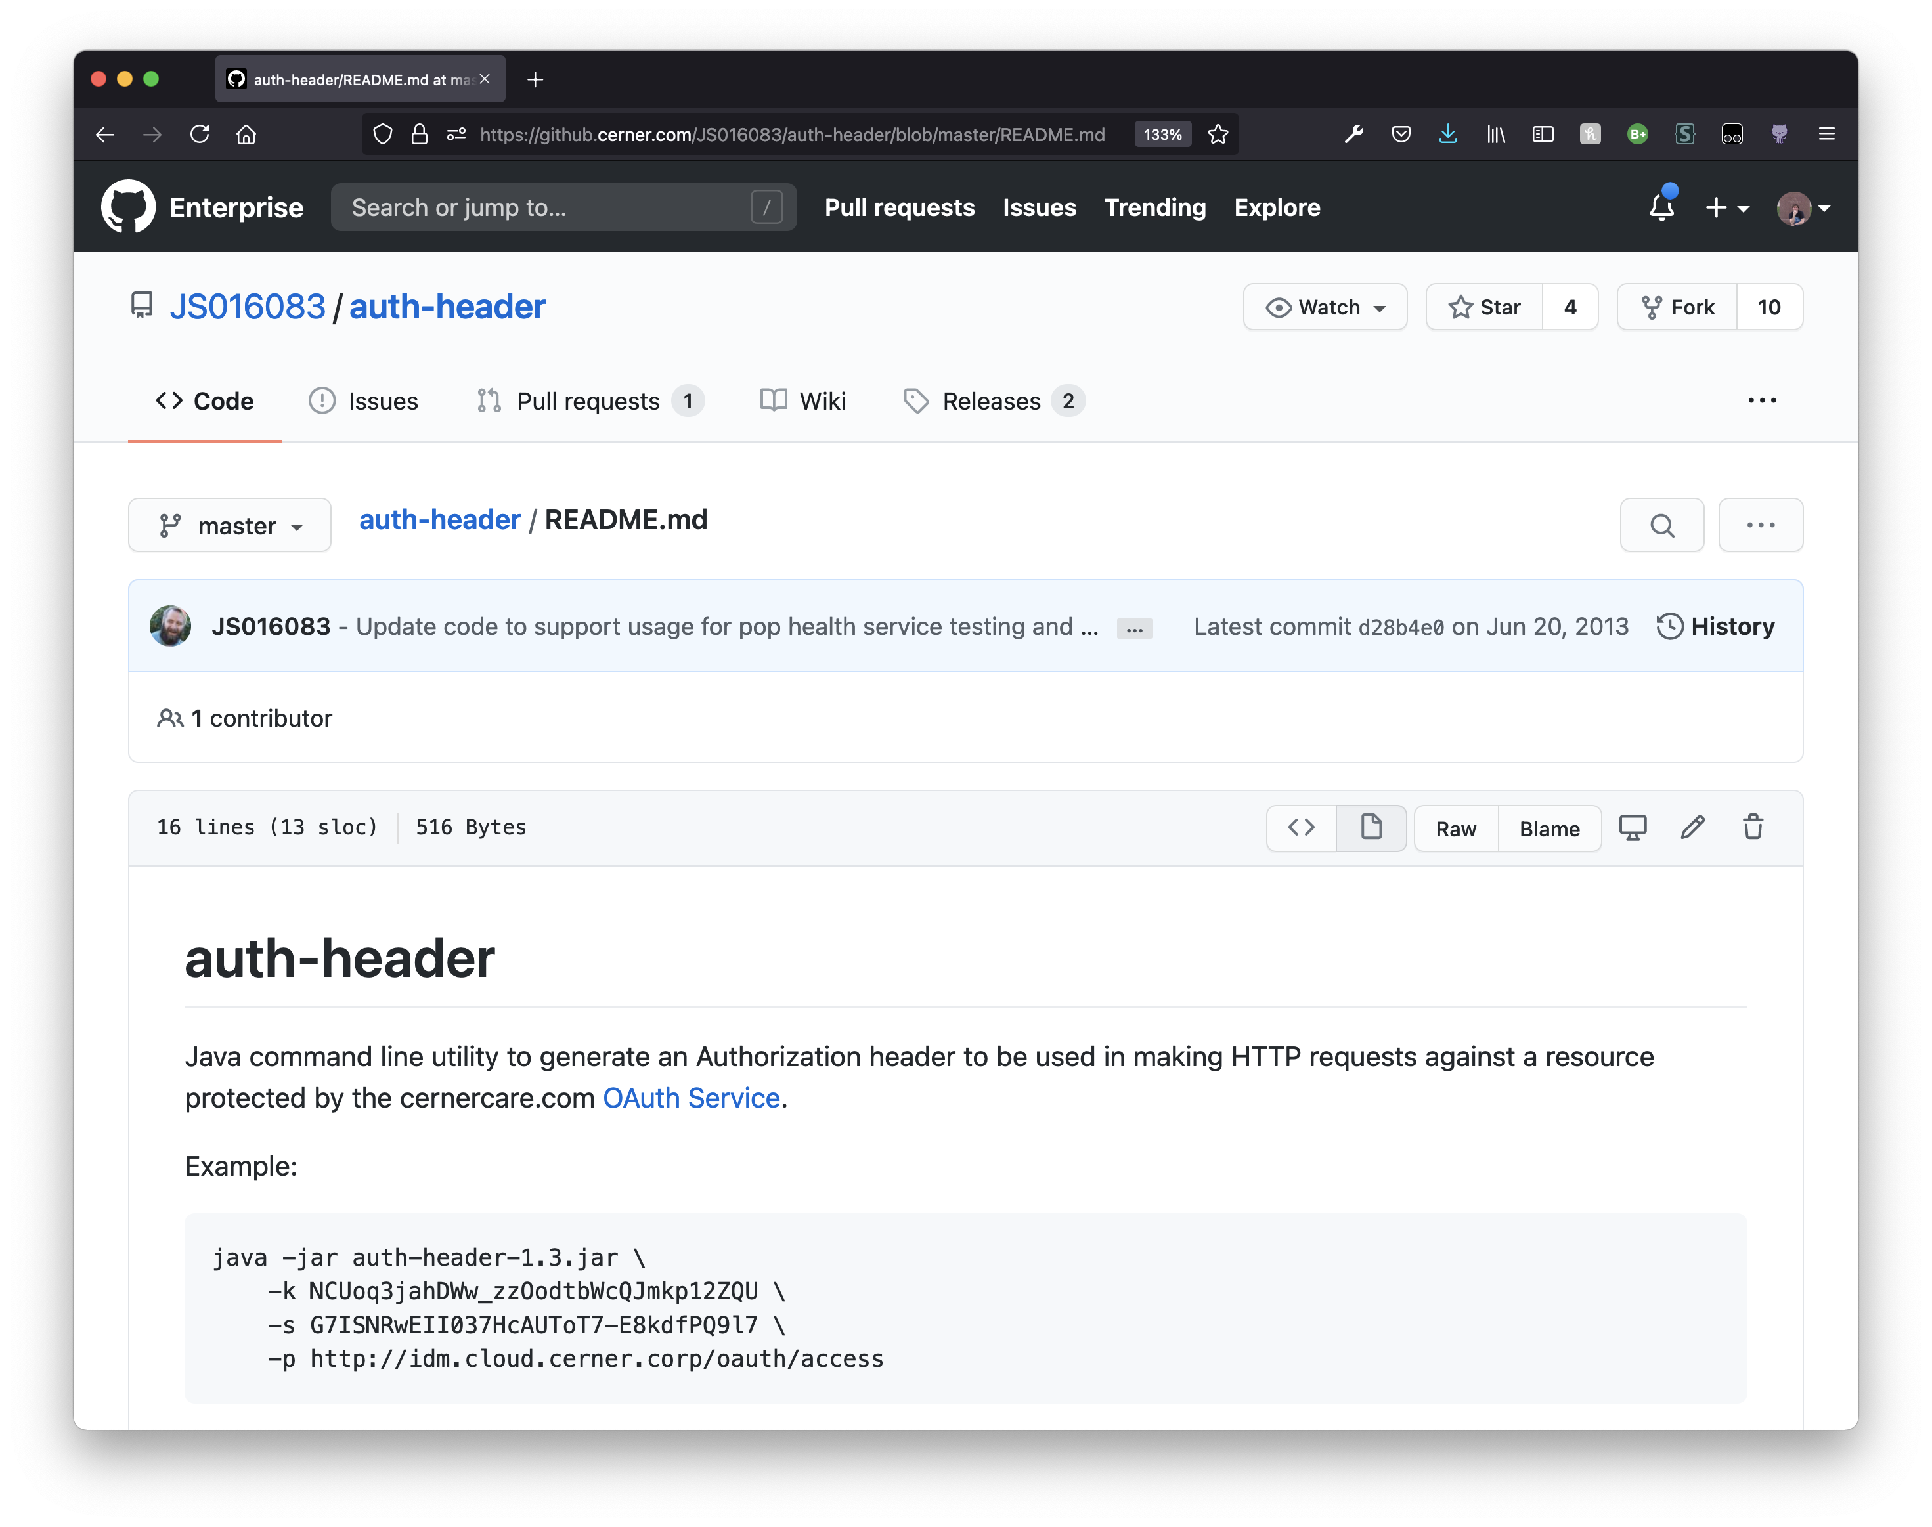
Automate OAuth
Thanks
John!
Notes:
When I first started testing APIs, I quickly ran into a problem. OAuth 1.0a (Cerner Version) is complex and complicated. I asked around a bit, and I found out there was this java JAR that John Scheeser (I’m sorry John if I butchered your last name) had made where you could pass in your credentials and get an OAuth Authorization Header.
But I hate passing credentials every time, so I wrote some shell aliases for it. If you’re not already aliasing everything you type in your shell frequently, you should be. But that’s a talk for another day.
Later, when I tried to share it with others, they didn’t know about my shell aliases. So I thought to myself I can do better.

Slide 42
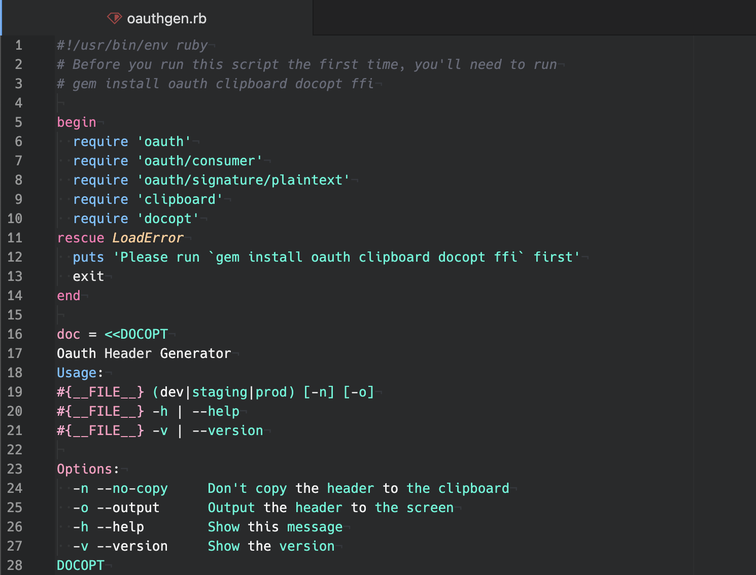
Automate OAuth
Thanks
Me!
Notes:
That led me to creating oauthgen.rb, a ruby file that would auto-generate that Authorization Header and even copy it to your clipboard. I even got to use one of my favorite python libraries that’s been ported to a bunch of languages called Docopt. It will generate a whole command line argument parser from a well formatted help text.
But this requires ruby and opening your terminal and having the script in your PATH. Way too much setup for a non-technical person like my product owner, Chris. And the clipboard part didn’t work on windows, either.
So I thought to myself I can do better.

Slide 43
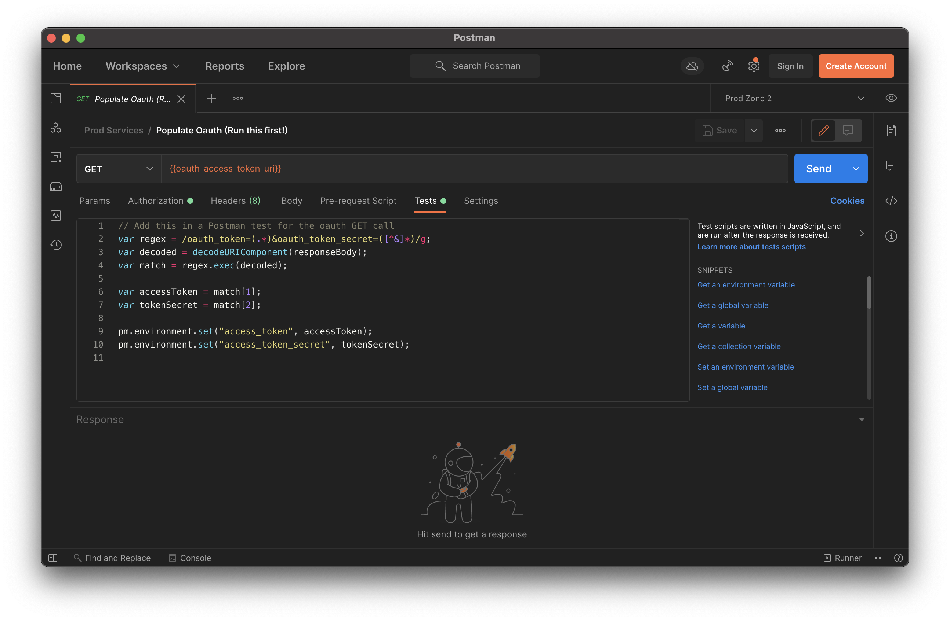
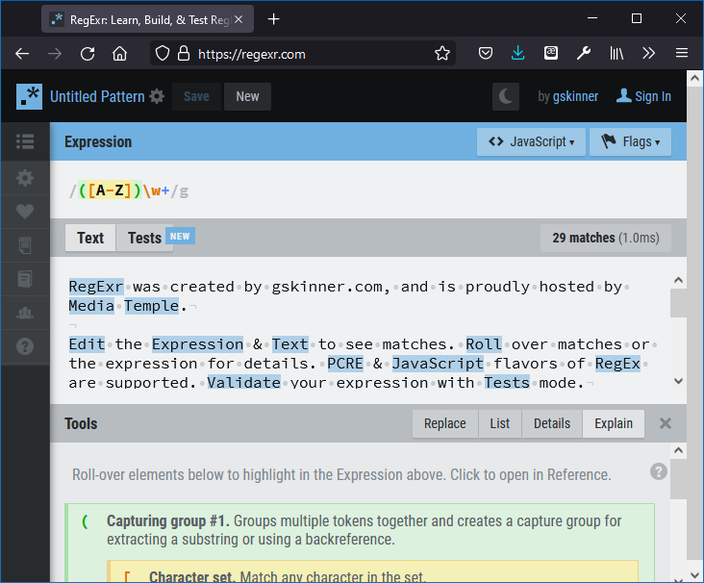
Automate OAuth
https://regexr.com/
Notes:
I can’t take full credit for this script. The basic idea came from an engineer who no longer works at Cerner named Patrick Boatner. But what it does is use regular expressions to parse out the important parts of the OAuth response from Cerner Central and it sets those as environment variables. If you struggle with regular expressions, I recommend a website called regexr.com. It’s fantastic for explaining what’s actually going on in a regex, and it compares it to your text in real time.

Slide 44
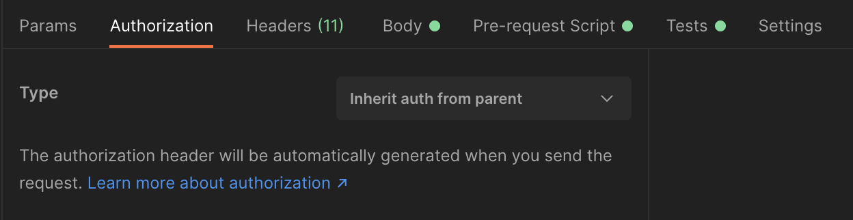
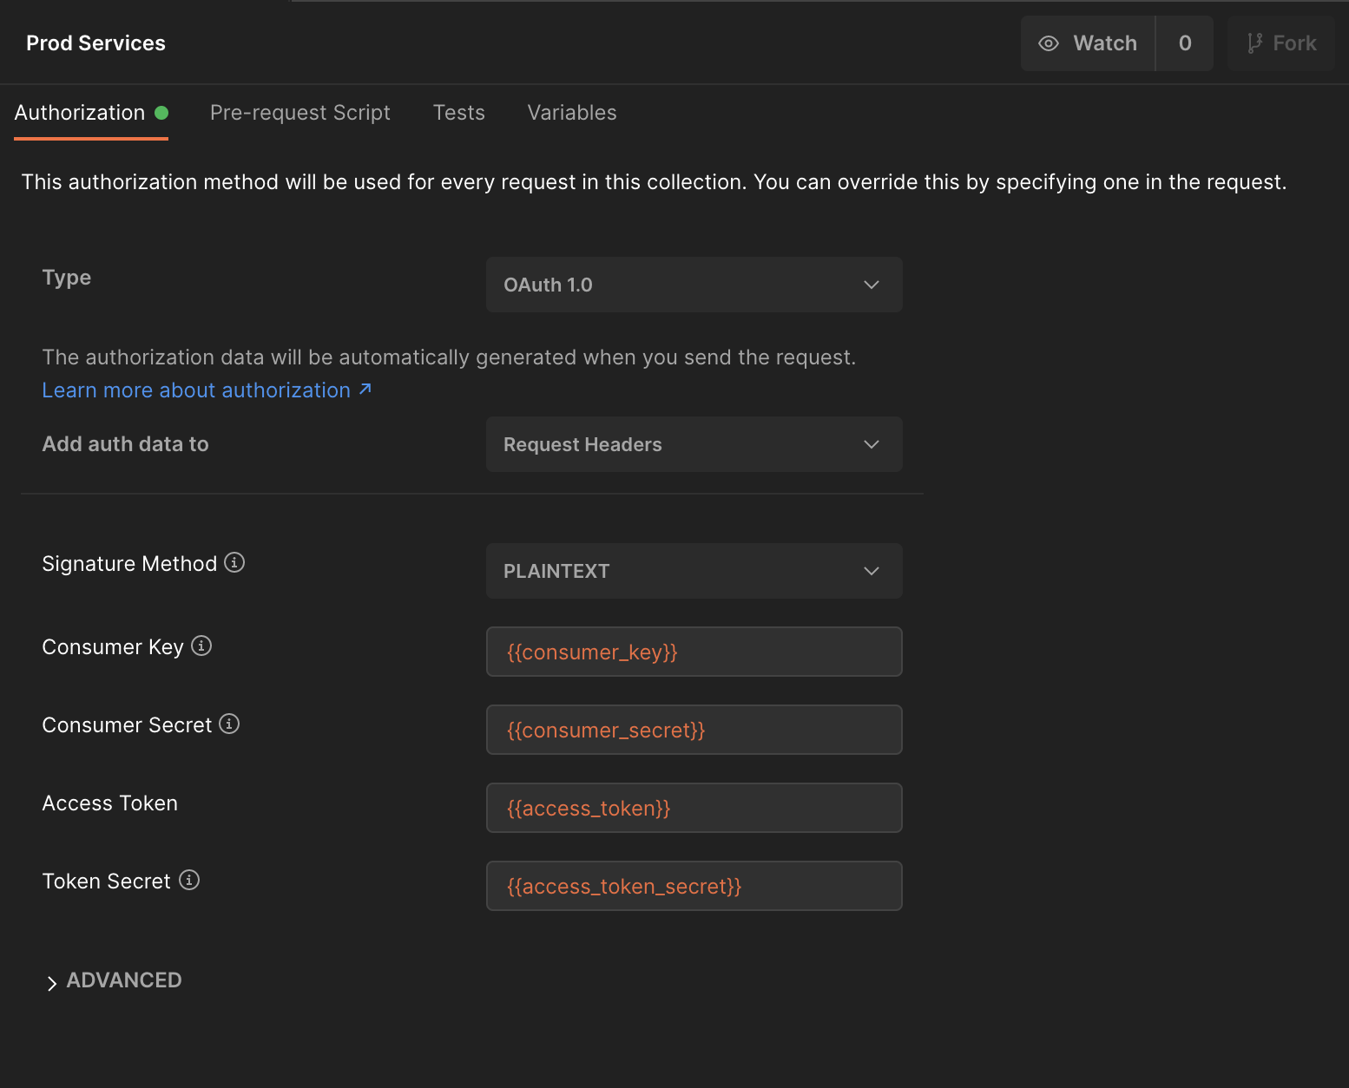
Automate OAuth
Each Request
On the Collection
Notes:
Parsing out the important OAuth bits means you can run this Populate OAuth request and use inherited collection auth to authorize your whole collection with it. You could go further than I have and make the other requests in your collection automatically run this one first, but this is lazy enough for me.

Slide 45
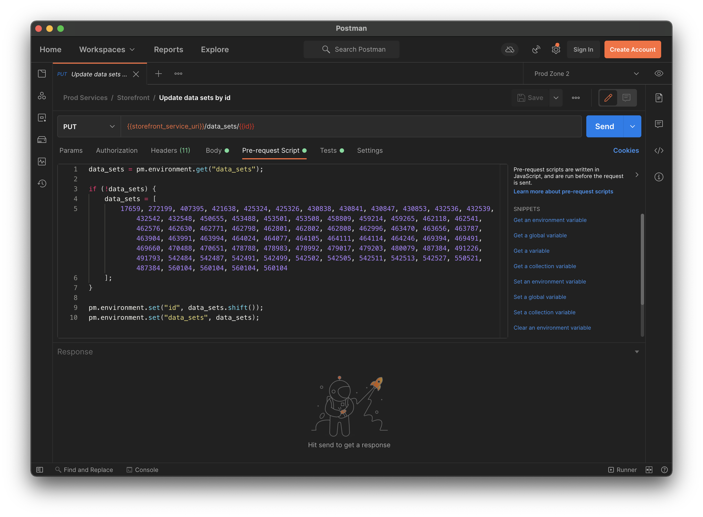
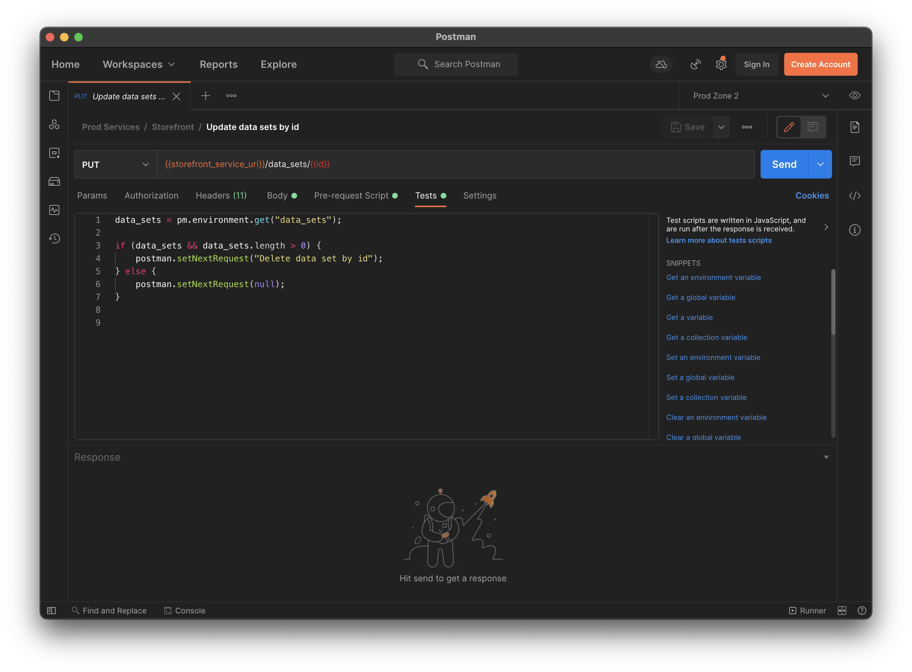
Loops
Notes:
You can also use postman to do loops. When I was on prod support, I had to run a bunch of updates and deletes one by one on a list of ids. If you set the list as a variable manually, then load and remove the next id from the list before each request, you can just click the request over and over until it fails from not having an id. If you want to make it a single click, you can tell the request to re-run itself in the Tests unless there are no ids left in the list.
You may notice that this is setting the next request to a different request. You can go to any request in your collection this way, and it makes it super easy to run a bunch of steps in sequence. One might even say an algorithm.

Slide 46
When to not use Postman
Notes:
And now for my most advanced topic. They say the hardest part of any tool is knowing when to use it. When should you not use postman? There’s a couple of places where postman just doesn’t make sense.

Slide 47
When TO use Postman
Notes:
But before we talk about that, let’s talk about when it’s a good idea to use postman. I sum it up in a single phrase: API discovery and testing.
If you’re faced with an unfamiliar API, Postman lets you explore it in a structured way. You can change one thing at a time in your requests, and the history tab will make sure all those changes are preserved if you mess up.
If you’re on a familiar API, maybe even one you develop, Postman will let you quickly and accurately make sure it is still behaving after your latest changes.
And that will bring us back to…

Slide 48


When to not use Postman
Notes:
When to not use postman. Don’t use postman in place of your web browser. Profiling and debugging a webpage are better left to other Firefox addons or Chrome extensions. There’s an amazing plethora of extensions for everything from accessibility to z-index counting. Use those instead of postman.

Slide 49

When to not use Postman
Notes:
If your scripts start exceeding about 50 lines, it’s probably time to start up an actual web service to handle the complex logic. Doubly so if you’re combining data from multiple requests to different APIs.
If you’re getting tenant info from over here, personnel info from over there, and content info from yet a third place, then you’re going to want a real programming language to splice all that together.

Slide 50
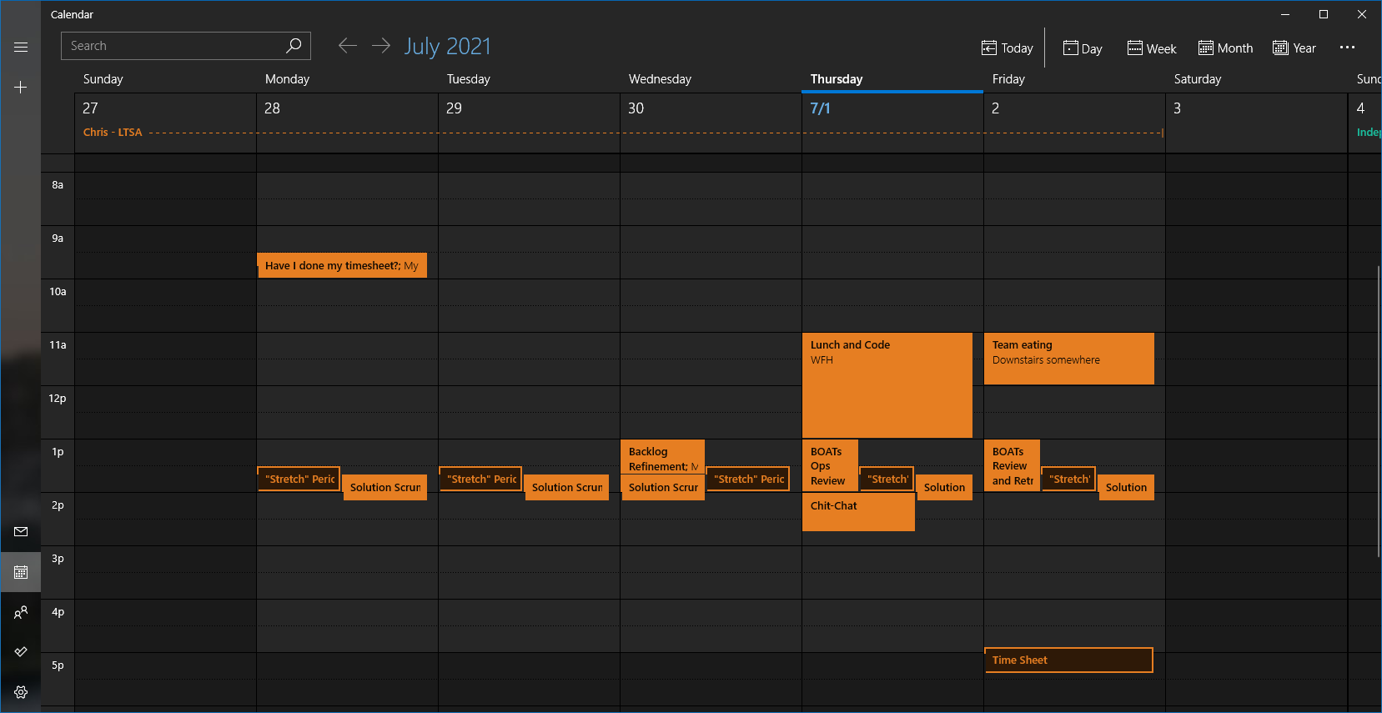
When to not use Postman
Notes:
Finally, don’t use postman for things you want to run on a schedule. While you can export a collection with a bunch of complex logic in it and run it with cron and newman, you shouldn’t.
Instead use a framework intended for running tasks on a schedule, like Ruby’s Rake gem. We have a ton of metronome jobs running rake tasks at scheduled times, and it allows us fine control over the code and the repetition.

Slide 51





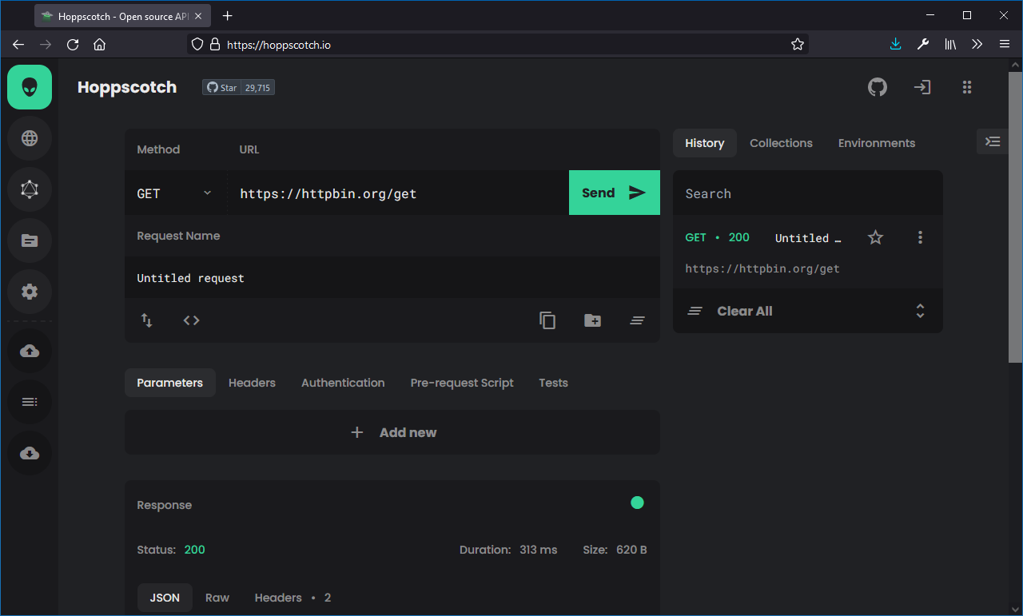
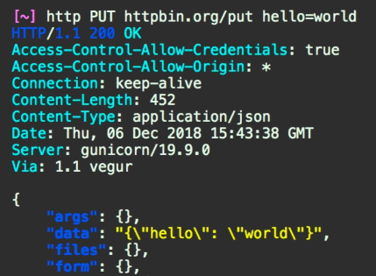
The Competition
httpie.io
Notes:
The final advanced topic I wanted to cover is what else is out there. Postman is not the only app or CLI that lets you make requests.
If you’re in a programming language, there are almost always built in libraries for making requests. I know ruby, python, and java well, so I’ll talk about those. Java has HttpUrlConnection, Python has Urllib3, and Ruby has Net::Http.
But I don’t recommend reaching for the defaults, because they have to be everything to everyone. For ruby, healtheintent’s additions to the Faraday gem, which you can find on GitHub as hi-faraday, make it easy to write your own service clients or do one off requests. In python, the requests library by Kenneth Reitz is the de facto standard. And in Java, I recommend the apache commons suite of libraries for every task. They remove all of the boilerplate and provide sane apis, which are sorely lacking in Java land.
Outside of code, on the command line, cURL and wget are the de facto standards. If you’re looking for more, I like the python package HTTPie, which adds nice syntax highlighting and an easy interface.
If you’re looking for more GUIs, the web based hoppscotch.io (that’s hopscotch with two Ps) is like a lightweight postman in your browser.

Slide 52

Fonts used in this presentation:
Orbitron
Courier Prime
Ubuntu
Bradley Hand ITC
Merienda
Color Scheme:
Background #343838 (cool gray)
Foreground #FFFFFF (white)
Accent 1 #005F6B
Accent 2 #008C9E
Accent 3 #00B4CC
Accent 4 #00DFFC
Accent 5 #E64823
Accent 6 #EE7547 (Postman orange)
THANK YOU!
Find me on Teams
Slides can be found at
bit.ly/caleb-on-postman
Notes:
And that’s all! Thanks everyone for coming to my DevCon talk. I’ll be around in the comments or later on teams if you have any questions at all. You all rock!

